Slide 1
Ako Aotearoa Research and Innovation Agenda (AARIA)
Information Session: Funding Change Projects in the Tertiary Education Sector
4/12/2023
Dr Marvin Hao Wu, Programme Manager, Research and Innovation, Ako Aotearoa

Slide 2
What this presentation will cover
What is Ako Aotearoa? What is AARIA?
Priorities
Selection Criteria
Pointers for developing an application
Questions and answers

Slide 3

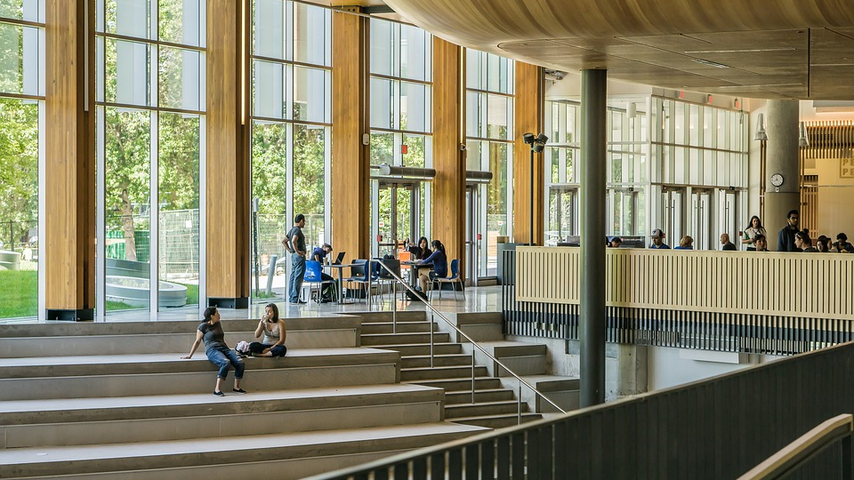
Our funds are available to all tertiary organisations to explore and evaluate new approaches that bring about positive changes in practice supporting learner success. All factors that affect tertiary teaching are important
2024 funding allocation
Value: $10,000 - $50,000 over the term of the contract
Type: Open and contestable
Duration: 5 months – 12 months
Total funding pool: $250,000

Slide 4

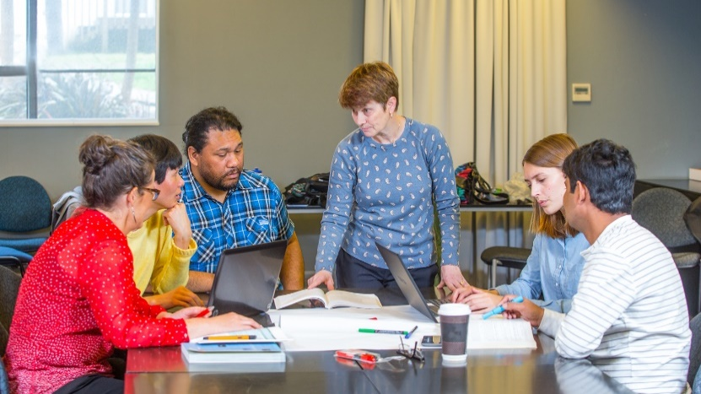
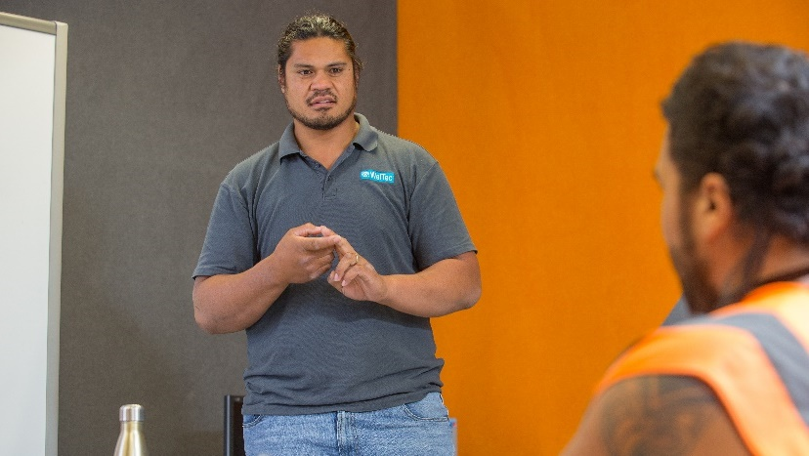
AARIA’s three key aims are:
Support the tertiary education system and contribute to better tertiary teaching and subsequently better learning outcomes for ākonga
Share research and innovation findings in ways that support teaching and learning, education and training, as well as supporting the interests of collaborating organisations or entities
Provide opportunities for collaborative work and networking that benefits all involved and contributes to building research capability

Slide 5
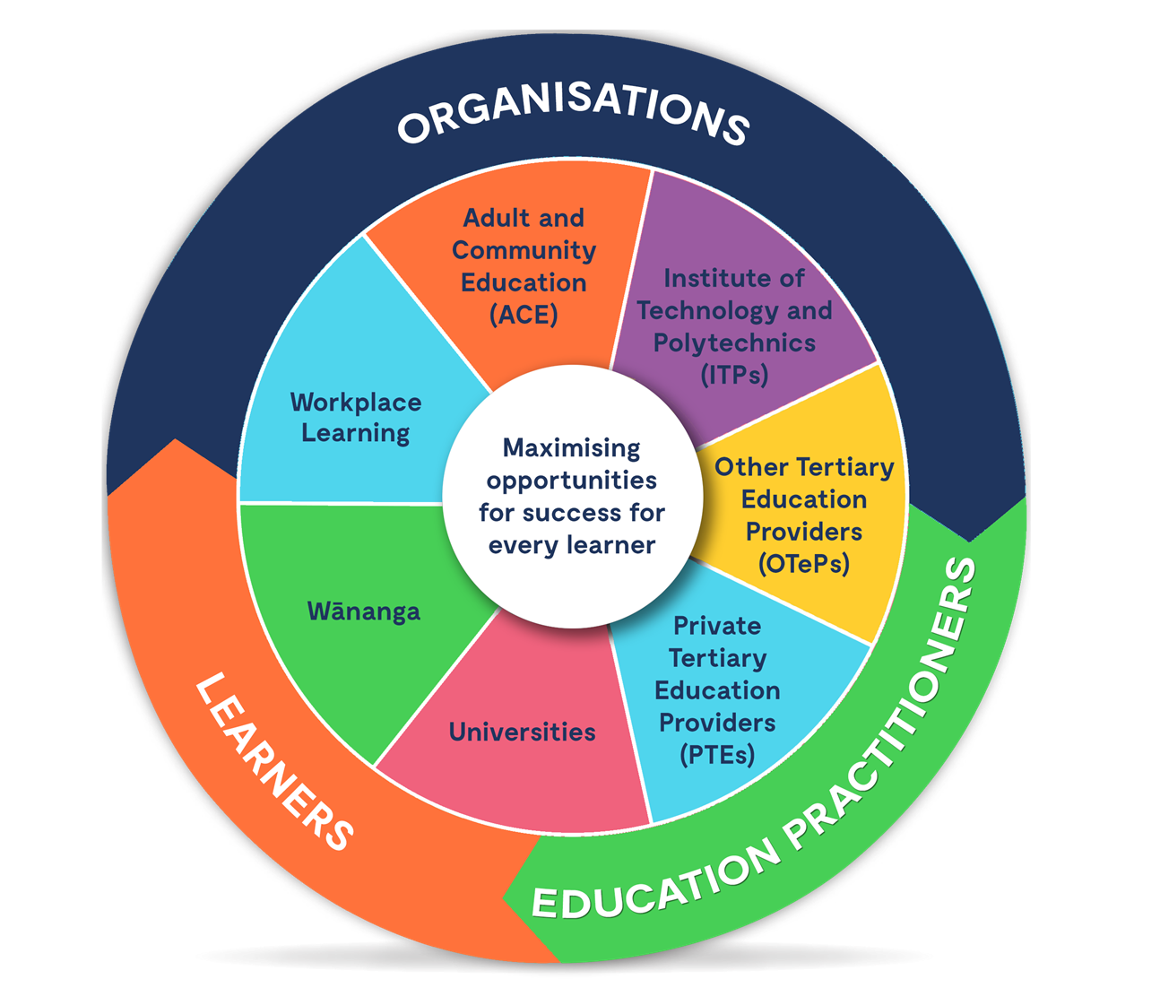
Our context
We work across the entire tertiary sector.
That means we actively work with Universities, ITPs, WDCs, ACE, Wānanga, Trusts, and PTEs

Slide 6
Priorities 2024
Broader Priorities:
1. Ōritetanga (Equity): Achieving system-wide equity for all ākonga, including Māori, Pacific, neurodiverse, disabled, youth, and learners from low-income backgrounds.
2. Te Tiriti o Waitangi (Treaty of Waitangi): Honouring Te Tiriti o Waitangi through tertiary education, including Te Reo provision, Kaupapa Māori education, Mātauranga Māori provision.
3. Auaha (Innovation): Responding to changes in education, especially developments in technology (eg: Artificial Intelligence), innovative and flexible programmes which can support the immediate needs of ākonga, tertiary education system such as Te Pūkenga and the Reform of Vocational Education (RoVE), and work-based learning.
4. Hua Akoranga (Learner Outcomes): Education and training that delivers for all learners, including supporting work readiness of all learners, online and distance learning options meets the needs of all learners, providing learning opportunities for people who wish to change careers.

Slide 7
Priorities 2024
Targeted Priorities:
Categories | Targeted Priorities
Education | Neurodiversity
 | Leadership and Management Training
 | Te Tiriti o Waitangi (Treaty of Waitangi)
 | Mātauranga Māori (Māori knowledge)
 | Action Research Projects
 | Reflective Practice
Technology | Artificial Intelligence
 | Information Technology
“Pacific Cultures” is in discussion to be added into the Targeted Priorities.

Slide 8
Selection Criteria
Quality of knowledge developed
Generates new knowledge
Identifies specific gap(s)
Builds on previous research/knowledge
Includes action research
Evidence of student engagement/student partnerships
Outcome-focused
Sound methodology

Slide 9
Selection Criteria
Quality of team
Collaborative
Diverse perspectives
Investigator capability
Reliability
Previous performance
Capability to deliver quality outcomes

Slide 10
Pointers for developing an application
Encouraging teams to build in user perspective through collaboration, partnership, in research team
Co-funding
Budget – breakdown of FTE (full-time equivalent) proportions for key personnel
Emerging researchers to be guided by mentors
Clearly included team FTEs in budget (principal investigators, advisors, research assistants)
Overheads – 20% max
2.5% to 5% from each contribution (organisation and Ako Aotearoa) for dissemination

Slide 11
Dr. Marvin Hao Wu
Programme Manager, Research and Innovation
Ako Aotearoa l National Centre for Tertiary Teaching Excellence
(Ako Aotearoa is hosted by Massey University)
Email: marvin.wu@ako.ac.nz
Website: ako.ac.nz
CONTACT US

