Slide 1
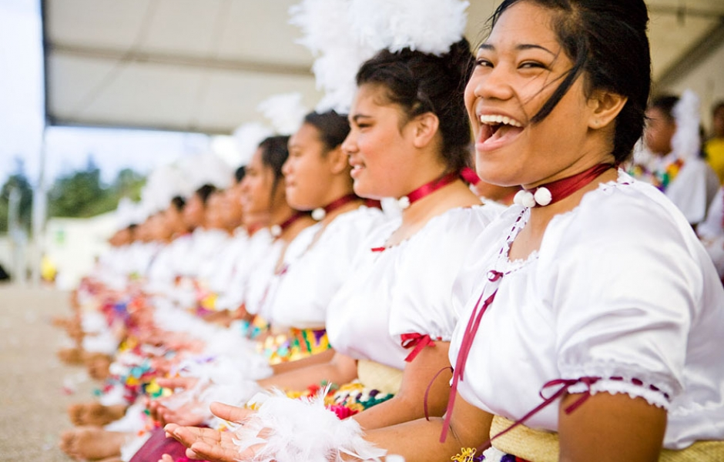
Bringing your whole self to work: Learnings from Tupu Tai
Notes:
Talofa lava, Malo e lelei and Happy Tongan Language Week to you all.
E muamua ona ou faatalofa atu, I le paía lasi lasi ua aofia mai I lenei aso. O outou paiá ma lo outou mamalu. Malo le soifua maua.
It is a pleasure for me to have this opportunity to share some thoughts, some learnings and to listen to the collective wisdom that is present in this room and in this conference. I would like to acknowledge all of you who are involved in the tertiary sector, teachers, students and agencies and partners who help shape the tertiary system and prepare Pacific students to enter the workforce. Programmes like Tupu Tai cannot succeed without the help, support and drive from university staff, family support, agency funding and also the drive and motivation from the students themselves.
My topic today, is bringing you whole-self to work. Learnings from the Tupu Tai Public Sector Internship Programme.

Slide 2
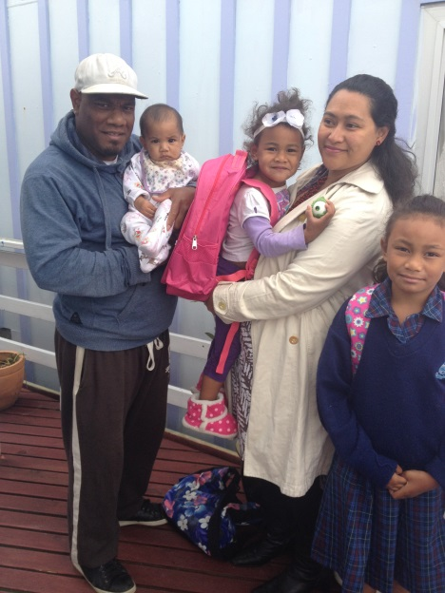
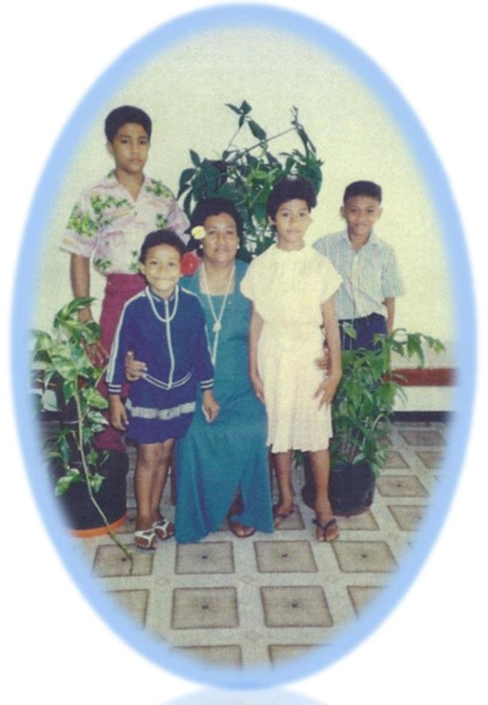
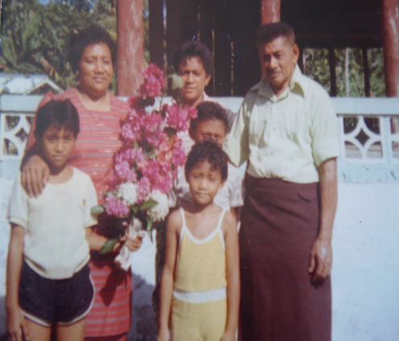
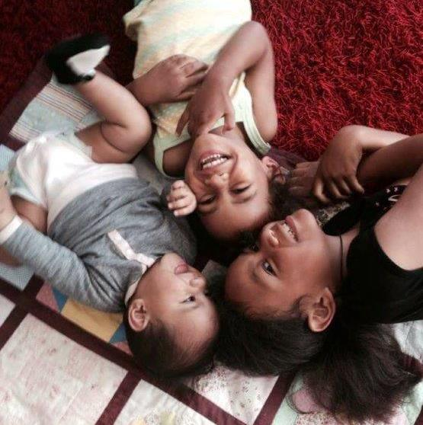
My story
Notes:
In staying true to my topic, I would like to begin with a bit of my story and what I bring to my public sector role, where I am the Policy Manager, Pasifika at the Ministry of Business Innovation and Employment.
My story starts back in Samoa. My mum, Fiu Leaupepe was a nurse and my dad, Leaupepe Pita was a plantation owner, a member of Parliament, a lover of learning. An immigrant, we moved to NZ when I was 10 in 1988. We lived in social housing with my aunty and uncle and their 6 kids in their 3 bedroom flat in Newtown until we were able to get a council flat in Newtown. After 10 years renting, my parents successfully saved for a deposit for a house while also making contributions to family and church both here and in Samoa.
I spent two years at St Anne's Primary in Newtown before attending St Mary’s college and then VUW here in Wgtn. I have a partner, Geoff Rahari who is from the Solomon Islands and we have three girls, Athena (11), Sofia (6) and Tiare (4). The struggle is real as a full time working mother.
I grew up with the Samoan proverb “O le ala I le pule, of le tautua’. The way to leadership is through service. I watched my parents serve our family through the many faalavelave, (family obligations) service to the church through fundraising and supporting church ministers and service to the country through their careers. This notion of service is what has shaped me and what I bring to the Public Sector. It is why the public sector motto of “Spirit of Service’ absolutely resonates with me and the values that I stand for.

Slide 3
What is Tupu Tai?
Tupu: To grow
Tai: Tide
Referring to the growing number of Pacific young people who will make up a larger proportion of the New Zealand workforce in the very near future.
Notes:
This is the only targeted pipeline for Pacific grads to get into policy roles in the public sector. There are mainstream programmes across the public sector but none of them have been able to successfully recruit Pacific people.
Bringing Pacific talent into the Public sector. Build their confidence and provide opportunities for them to gain real experience in the policy world.

Slide 4
Why is Tupu Tai important?
Trends in Senior Leadership in the Public Sector
% | 2005 | 2011 | 2012 | 2013 | 2014 | 2015 | Public Service Workforce (2014)
Women | 48.5 | 39.6 | 42.1 | 41.5 | 42.0 | 44.2 | 60.5
Maori | 9.8 | 9.2 | 9.6 | 11.2 | 12.0 | 11.1 | 16.4
Pacific Peoples | 1.3 | 1.6 | 1.7 | 1.8 | 1.8 | 2.6 | 8.0
Asian | 1.6 | 1.9 | 2.6 | 2.3 | 2.4 | 2.1 | 8.5
1.3% (34) Pacific Policy workers in the whole public service
Seeing is believing
Notes:
When I entered the Public Sector 13 years ago as a Policy Analyst with the Ministry of Pacific Island Affairs (now Pacific Peoples). The vision back then was that in 50 years time their would no longer be a need for a Ministry for Pacific Peoples’ because through the Ministry’s Pacific Capacity Building initiative, all government agencies would have built their own Pacific capability both in policy and operations in order to deliver to the growing Pacific population. And the role of the Ministry was to support agencies to build their internal capability and to hold agencies to account.
One of the biggest issues back in 2005 was that representation by Pacific people in senior leadership across the Public Sector was very low. (1.5%). Fastforward 10 years later – and the picture has changed slightly but not a lot.
Where gaps begin to emerge
Gaps begin to emerge when we look at senior representation in the Public sector. In 2015, Senior Leadership consisted of Maori made up 11%, Pacific 2.6% and Asian 2.1.
In the policy space, this gap is even more pronounced, where out of a policy workforce of 2,100, only 1.2% (34) people are of Pacific descent.
Why?
No pipeline of Pacific people coming through the policy recruitment process. Senior Management roles in the public sector often come from those with policy experience.

Slide 5
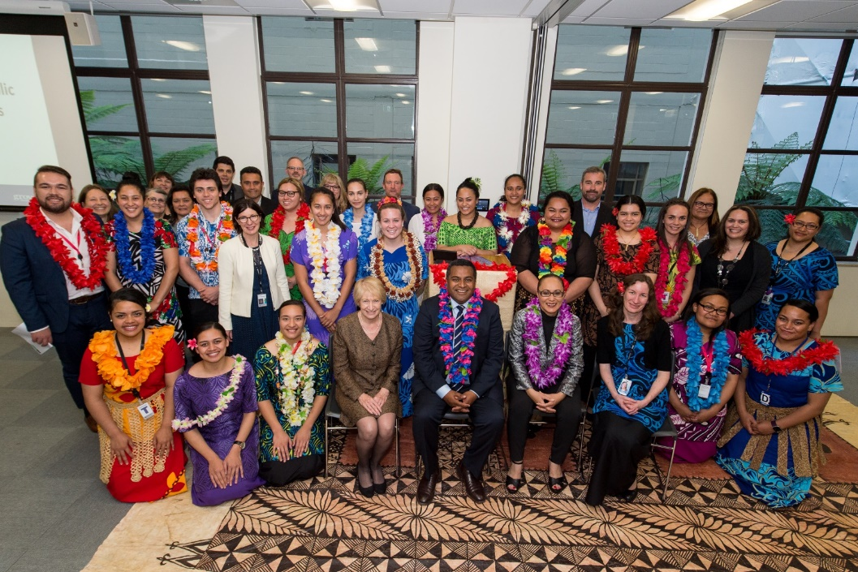
Tupu Tai and the Tupu Family
Tupu Tai – Public Sector Internship Programme – Policy
Tupu Tek – IT Internships (Summer of Tech)
Tupu Toa – Corporate Pathways (Tupu Toa Tust)
Notes:
These initiatives responds to the gaps that currently exist for Pacific people. Success for Tupu Tai and Tupu Tek will be increasing the number of Pacific people in policy roles within the next 3-5 and then creating pathways for them to move up in their careers. We don’t expect Tupu Tai to be there forever but we do expect it to be a model that can be used for other sectors where we want Pacific people to progress in the future.

Slide 6
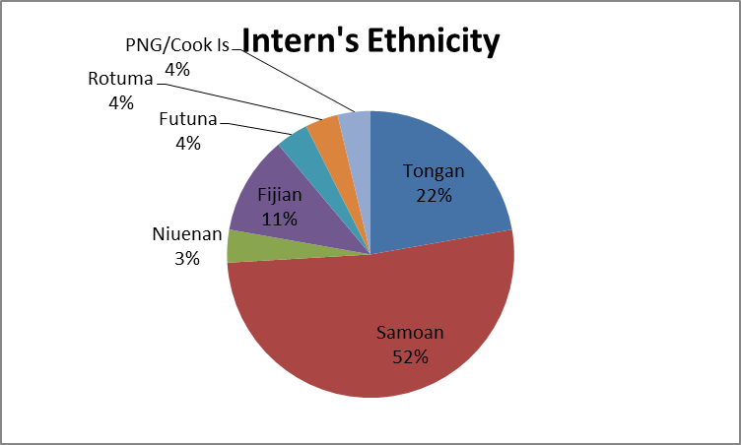
Intern Profile
Notes:
Total – 248 applicants
91- assessment centre
57 – interns
The interns are put through a rigorous recruitment process from CV, video, written, assessment centre stage – matches the MBIE process. As a result of us mirroring the MBIE mainstream process, this year, MBIE has created a fast track for MBIE interns to straight into the selection pat of the mainstream grad programme as long as then meet all the criteria.
The feedback from students on the process was that, after going through the gruelling Tupe Tai process, every other job they have applied for has been a walk in the park. To date, 100% of interns who have finished studying and have been through Tupu Tai have gained employment either in the public sector and a couple in the private sector.

Slide 7
Learnings
Public sector context
Many policy groups in the public sector have never worked with a Pacific person before (34).
Cultural capability to know and understand a Pacific worldview is limited in many parts of the public sector.
Workplace cultures can force assimilation rather than integration
- not being able to bring your whole self to work
“Success is being able to switch off my Pacific self and put on my corporate hat when I come to work”. (Tupu Tai intern)
Notes:
Through placing interns into different policy teams across the public sector, we learnt that many policy groups have never worked with a Pacific person before. Tupu Tai interns became champions for Pacific perspectives and provided agencies with an opportunity to learn what its like to work with someone from a different culture.
There is a genuine lack of cultural capability across many policy teams to deal having a Pacific person in their teams and a genuine wish to make sure that they can support a Pacific person in their teams.
In the meantime, NZ as a country is becoming more and more diverse. Auckland is the 4 most diverse city in the world and yet in our workplaces, this is not reflected – certainly not in policy.

Slide 8
Learnings from the nation-wide roadshows
Student influence is the most impactful way to reach students.
Pacific students are not accessing the Student support services, career services as best as they could.
As am employer, their seems to be a disconnect between studying at university and getting a job.
Lots of Student Networks, sometimes running their own, mentoring, careers evening, duplicating effort.
Notes:
Better connection between Student Support Services or Pacific team and student leads to better outcomes
Some student support staff do not feel its their job to reach out to students
Questioned, who should be educating students about employer expectations.

Slide 9
Learnings through the recruitment process
CV
Video
Written
Assessment Centre
- interview, group assessment and critical thinking test

Slide 10
Bringing your whole-self to work
Our Pacific languages, cultures, way of seeing the world sets us apart – it is our competitive edge. Don’t leave it at home!
Diversity and Inclusion is now a priority for Govt agencies– this is our time.
Role for Pacific Studies and Pacific Language course to really shape and make a difference.
Notes:
Story of the Tupu Tai intern leaving their Pacific side at home.
Cultural intelligence is the new currency and we have plenty of it. We need to cash in on that.
Pacific people are scarce in policy roles – our presence makes a difference

Slide 11
Where to next for Tupu Tai?
Employment – higher household incomes
Career Progression into leadership roles in the Public Sector
Pivoting into growth sectors and new frontiers…NASA, Space…

