Slide 1
“RESHAPING PASIFIKA”
Samson Samasoni
Chair, Wellington City Council Pacific Advisory Council
6 September 2018

Slide 2
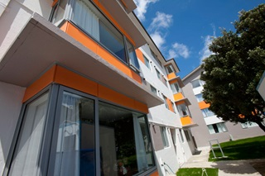
How can local authorities & Pacific community-based entities support the educational outcomes of tertiary education learners through evidence-based, strategic policies and activities?
10-Year Plan
Record number of Pacific submissions – over 3% from Pacific community.
Mayoral Event
Pacific School leaders being recognised at Reception. Youth Council places.
Housing Fono
PAG exploring development of a Pacific housing fono.

Slide 3
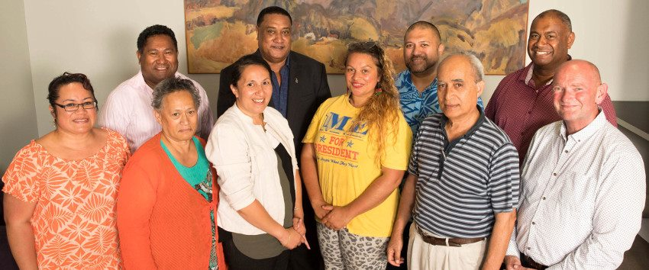
Pacific Advisory Group role since 2003:
facilitate consultation with Pacific communities
help Pacific communities understand Council processes
enable Pacific peoples to participate in the Council's decision-making processes
help the Council understand the needs of Pacific communities and how these may be addressed in the context of the Council's roles and priorities

Slide 4
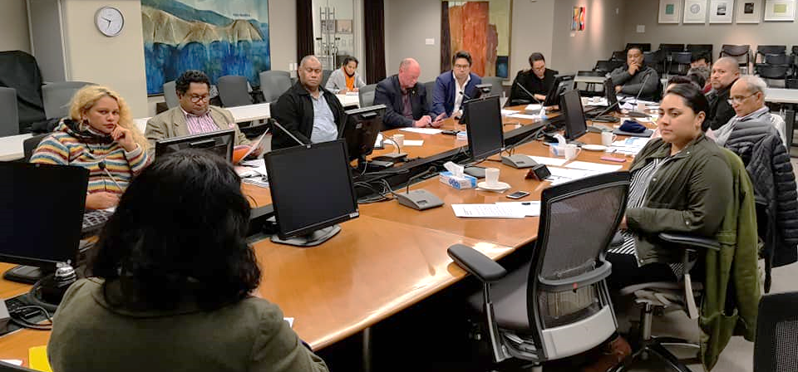
PAG Portfolio Groups
Governance
Health & Wellbeing
Economic Development
Arts & Culture
Youth
Communications

Slide 5
STRATEGIC APPROACH – POLICY FOCUS – RESHAPING ISSUES
Understanding Pacific people and communities
Considering impacting or issues for Pacific communities
Creative solutions, facilitating meaningful outcomes

Slide 6
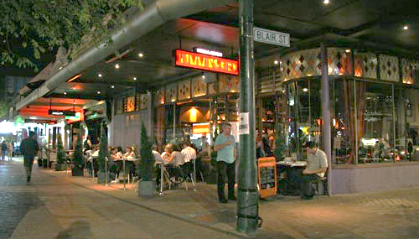
NIGHT TIME ECONOMY
Why is this a Pacific student/learner issue?
Financial pressures on family
Student part-time work opportunities e.g. safety, transport etc

Slide 7
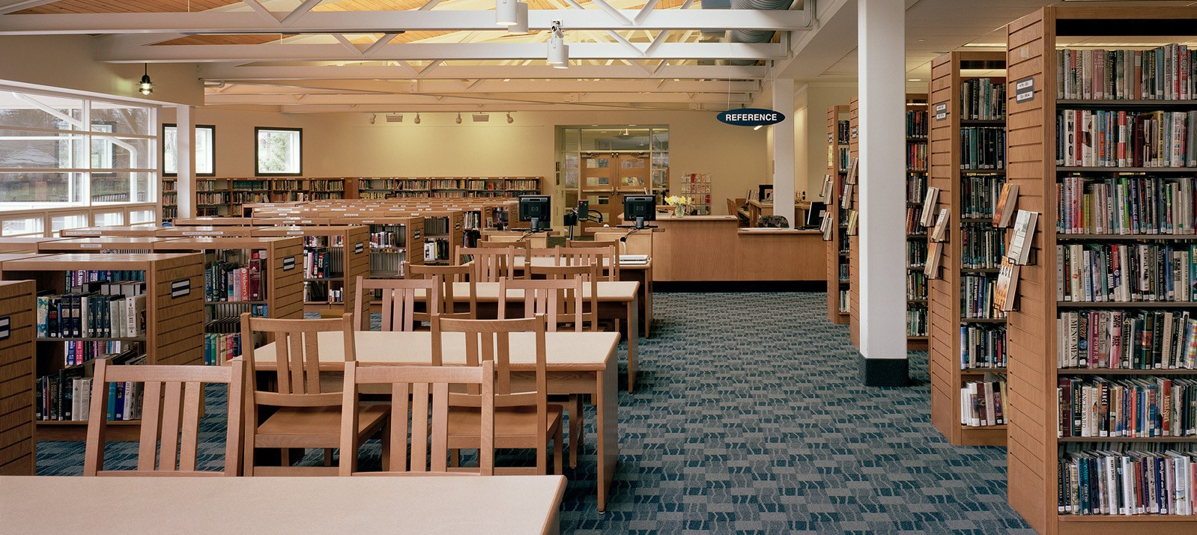
STUDY & HOME ENVIRONMENT
Home Environment - Connectivity, over-crowding, extended family living etc
Public Libraries - Open 10am-6pm, Saturday some open 10am-12pm, Sunday closed
Community spaces – do they offer solutions?

Slide 8
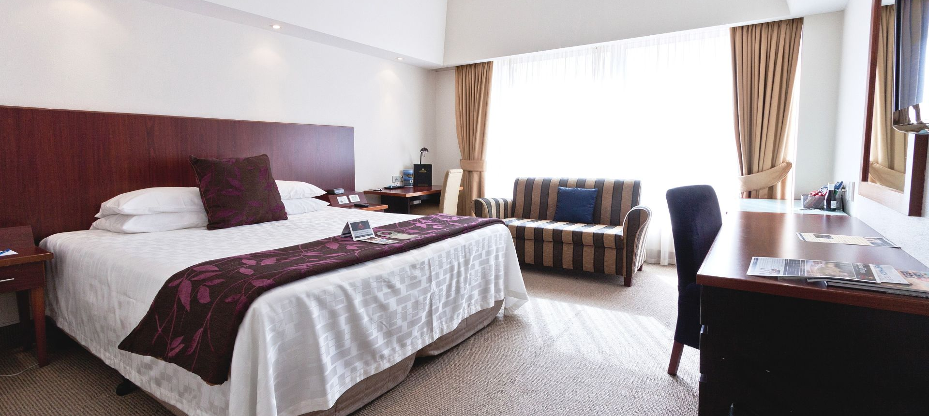
STUDENT HOUSING
Communal living – talking with Council
Furnishings – hotels etc
Extended family living

Slide 9
Are we asking the right questions?
Are we reshaping the issue around Pacific peoples and what we know?
Are we being creative in our approach and reshaping solutions for Pacific learners?

Slide 10
THANK YOU

