Slide 1
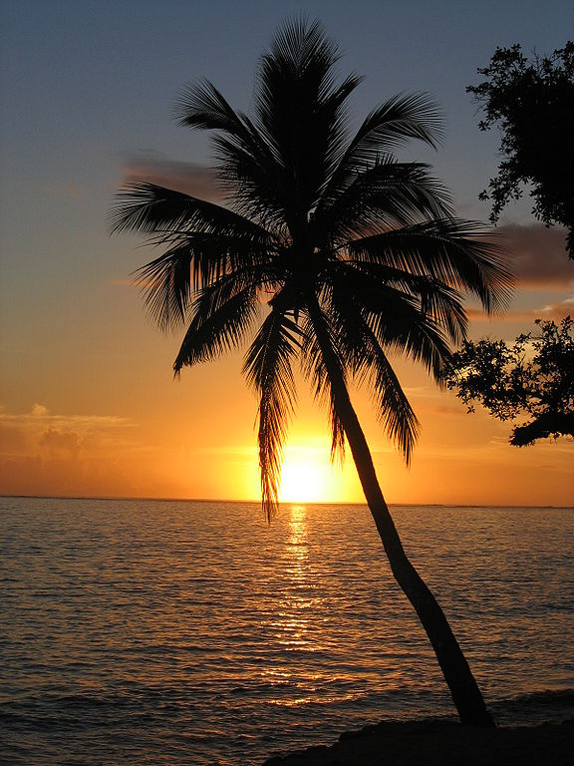
A time with Alofa… Pacific pronunciation and protocols

Slide 2
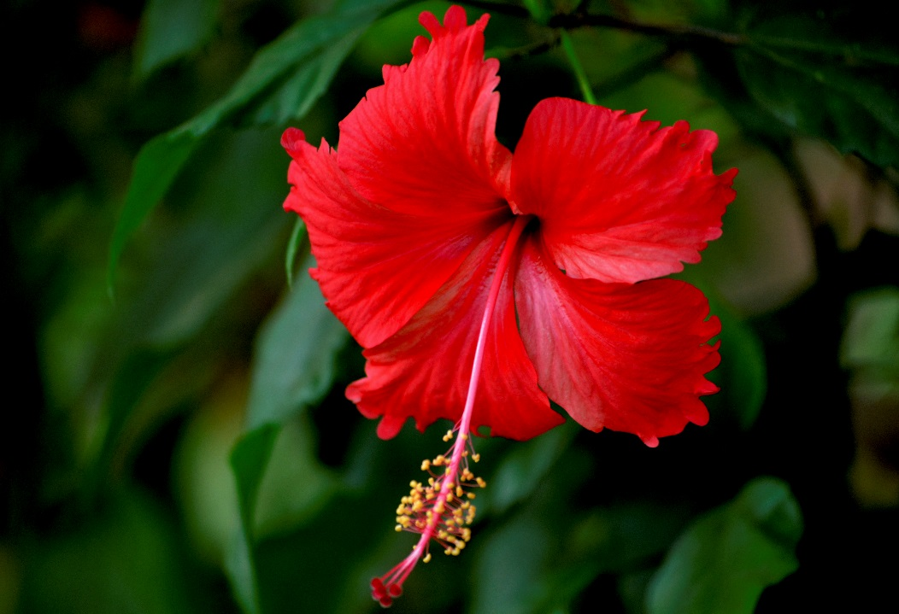
NZ is a Polynation
Who am I?
Daughter of the Hibiscus

Slide 4
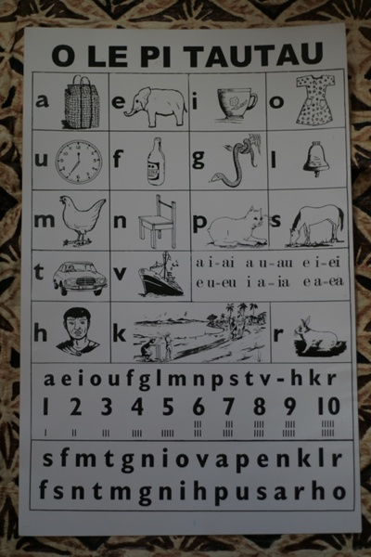
Samoan Language (Gagana Samoa)

Slide 5
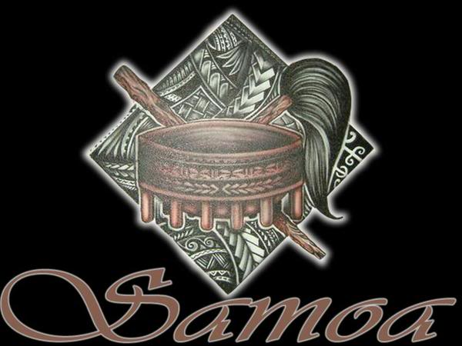
Basic Greetings (Fa’afeiloaiga)
Talofa lava ……. Hello………
O lo’u igoa o…. My name is…..
Manuia le aso/po Have a good day/night
Tofa soifua Goodbye

Slide 6
We are Samoa
What does it mean to be Samoan?
E iloa le tama ma le teine Samoa i lana tu ma le savali, fa’apea lana tautala.
You can tell a Samoan by the way they stand, the way they walk and how they speak.
O le ala i le pule o le tautua.
The way to power/leadership is through service.

