Slide 1
What role do
Tertiary Education Institutions
play in facilitating contact and friendship formation between
international students from the Pacific Islands and New Zealand students?
Franco Vaccarino
Angela Feekery
Vivita Matanimeke
7 September 2018

Slide 2
human relationships
Initiating and maintaining relationships with others is one of the most necessary and challenging functions of human life and survival.
We are connected to others in different ways: through family, social groups, ethnic communities, friendships, organisations, and social networks.
We define ourselves and evaluate others through these relationships.
A basic need of interaction is inclusion = a sense of belonging or being involved with others.
Neuliep (2014)
Liu, Volčič, & Gallois (2011)

Slide 3
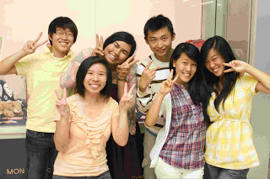
Friendships are seen in different ways and constructed differently around the world

Slide 4
What does a friend mean in your culture?

Slide 5
Gareis (2000) points out six factors which influence intercultural friendship formation for international students:
Culture (e.g. value systems, sex roles, importance of status, collectivism vs individualism)
Personality (strong cultural identification)
Homophily (i.e. similarity between people = main function of friendship)
Adjustment stage
Communicative competence (most often mentioned factor influencing friendship formation)
Proximity (contact with host nationals)

Slide 6
our research
Aims
to explore the friendship formation between international students from the Pacific Islands and New Zealand domestic students
to examine what Massey University can do to facilitate intercultural contact and friendships
Limited research done on friendships with
international Pacific Island students

Slide 7
methodology
talanoa + online survey
Talanoa aims at reaching understanding towards the building of relationships.
Focus group aims at gaining knowledge.

Slide 8
findings
Definitions of Friendship
A friend is a very special person who is still around after you've shown them your weakest and ugliest side.
Friends feel a sense of belonging to each other.
A friend is someone who understands you no matter the differences that exist between the two of you.
Friendships are a positive thing; it adds value to the quality of your life.
It’s like I’m connecting with someone, like sharing the same values.
A friend is someone who helps you grow as a person.
Friendship to me means a person that is reliable, someone that I trust.
We treat friends like family.
It’s like a sister or a brother.
They’re like you’re second family kind of thing.
I don’t really have friends. I have family. I mix my friends with family.
It’s just like family. I mean, being with your friends is just like being with your family.
I think for us it’s like part of our culture or something. Like really close. It’s a community.

Slide 9
Benefits of having Pacific Island Friends
Shared Pacific understanding
There’s that silent understanding that you have.
You know the same rules and cultural practices therefore they may understand you better.
Like they understand you more, and they can relate to you.
You have a sense of belonging.
It makes life easier ….. like you don’t feel like you’re lonely.
Like family
They will treat you like family no matter where.
They are your family away from home - safe haven when things go wrong.
Language
Sometimes you just want to talk in your language with someone.
Support
I think support would be the biggest one.
We can support each other.

Slide 10
Benefits of having New Zealand Friends
Learning new things
Like you’re a more well-rounded person by interacting with them and knowing about them.
They share their culture with you.
Learn from them - you learn how they do things differently.
They can help you adapt to the lifestyle/culture etc.
Broaden one's knowledge and experiences.
We learn a lot from palagis, for instance their time management skills is something that I admire.
Open your mind to news ways of thinking
Kiwis really give you that freedom to be yourself and to give you confidence because they just make you come out of your shell and just express yourself freely.
You get to develop yourself and then you get to be comfortable being yourself.
Different perspectives so we learn new things.
Makes you more understanding because you are exposed to a different culture.
Different perspectives allow me to go out of my comfort zone.
Help/support
They help you with your academic stuff because they’re really good at English.
I always go to them if I need help with like white things.
They can help you with some English language and the way of living in their country.

Slide 11
Barriers to making New Zealand Friends
Culture/lifestyle
I think the main barrier is the culture difference.
It’s just culture. It’s just like we’ll say some things they just don’t understand, you know? There are those common things we have with our Islanders that we don’t have with them.
Well, they don’t understand how we are, so we don’t click.
I don't have the same cultural reference points as they do so I don't get some things they do.
Their values and morals are different from mine.
Stereotyping/racism
“Must be an Islander” when something bad happens. And when you hear it as an Islander who came from the Islands, you feel anger, but mostly sadness.
I think there’s a bit of racism.
It’s the stereotyping. The common stereotyping is that Islanders are not smart.
They sometimes don't understand your way of life and culture and sometimes judge you because of it.
Language/accents
Sometimes I didn’t understand them.
Maybe you speak good English, but they don’t understand your accent.

Slide 12
So what do Tertiary Education Institutions have to do with international Pacific Island students’ friendships?
ACADEMIC
Tertiary Education Institutions
SOCIO-CULTURAL
Friendships

Slide 13
Social relationships play a critical role in enriching quality of life (Schalock 1996; Brown 1999).
These relationships are viewed as necessary for emotional well-being because they provide a sense of feeling loved and valued (Bayley 1997).
They are a source of social support and contribute to good mental health (Newton et al. 1994).
Friendships promote a sense of being connected and create a sense of belonging.

Slide 14
WELLBEING
BELONGING
key ingredients to educational success of students
So should Tertiary Education Institutions play a role in international students’ “socio-cultural” component?
YES

Slide 15
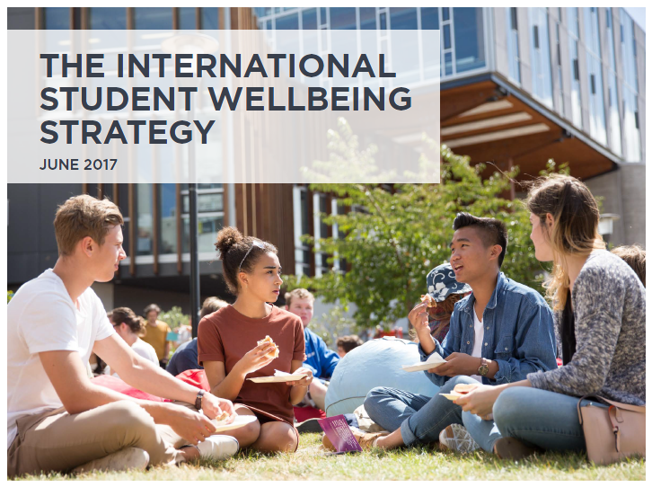

Slide 16
“International students have told us that the issues that can have a significant
impact on their experience here include meeting costs of living, employment
and exploitation, access to health services and counselling, and social
connectedness, including making friends while in New Zealand.” (p. 6)

Slide 17
Formal Intentional Structured Interventions (FISI)
Formal intentional structured interventions promote contact between international Pacific Island students and domestic New Zealand students.
Formal intentional structured interventions can help reduce the cultural and communication barriers between international and domestic students.
Without formal intentional structured interventions, there could be the tendency for international Pacific Island students “to hang out with other international Pacific Island students”. This is not a bad thing, but …..
Through formal intentional structured interventions both international and domestic students can become more culturally and globally inclusive citizens of the 21st century.
Initiatives and incentives for promoting intercultural interactions within formal intentional structured interventions need to be considered.

Slide 18
What do these
Formal Intentional Structured Interventions
look like?

Slide 19
What can Massey University do to help facilitate contact with domestic NZ students?
More social events that help international students interact with New Zealanders as this will build confidence to make friends
Create cultural awareness events where not only New Zealanders can become aware of other cultures, but also vice versa
Educate people about Pacific Islanders (like festivals)
Instead of having halls specifically for international students, Massey should mix internationals with domestic students, not seclude NZers from other cultures
Cultural nights
Instead of putting up culture days and those kind of activities, create events where we are not performing or at the centre of attention, but are actually forced to mingle with NZ students.
Weeks such as Pacific language weeks should be showcased on campus so there’s more awareness from non-PI students and staff
More events that encourage cross-cultural interactions
Make sure that all students are educated on other cultures and the differences.
intercultural communication training

Slide 21
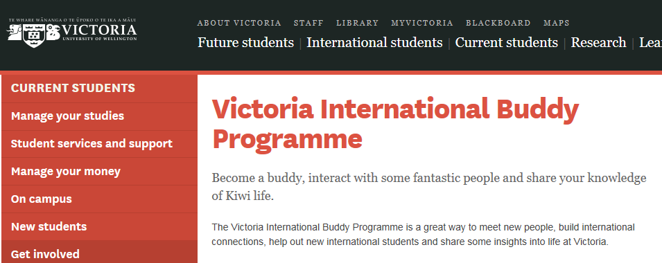
https://www.victoria.ac.nz/students/get-involved/international/buddy

Slide 23
UCIC Buddy
Activity
UCIC Buddies help run UCIC’s Orientation Programme. Each Buddy is responsible for a group of 3-5 new students, helping them to settle and integrate into UCIC, UC and Christchurch. Buddies meet with their group at least once a week for the first four weeks of the semester.
Hours involved in the activity
12 hours.
Every 12 hours of participation in an activity is equal to one intersection point (12 hours = 1 intersection point). For this activity you can claim a maximum of 2 learning and development outcome.
http://www.canterbury.ac.nz/life/co-curricular-record-ccr/ccr-activities/ucic-buddy

Slide 24
Tertiary Education Institutions are in a prime position to champion and promote systemic interventions to assist both international and domestic students to engage with each other in order to promote cultural understanding.

Slide 25
Malo 'aupito
Faafetai
Vinaka
Tenkyu
Meitaki
Kia ora
Fakefetai
Fakaaue lahi

Slide 26
Take away message
Tertiary education institutions play a crucial role in providing intercultural spaces to facilitate intercultural interactions between international Pacific Island students and New Zealand students. Some of these intercultural spaces include:
Formalising buddy or peer-mentor programmes (with appropriate recognition) to assist with the academic and socio-cultural adaptation of new Pacific Island students.
Holding more student events throughout the semester so that all students can learn about different cultures, perceptions, food, communication, language, entertainment, and new experiences.
Arranging local community volunteers to spend social time with Pacific Island students and build reciprocal intercultural relationships.
Providing new Pacific Island students with intercultural communication workshops (co-facilitated by New Zealand students).
Providing culturally mixed residential halls on campus where friendships can develop naturally (rather than separate halls for international and domestic students).
Showcasing Pacific language weeks on campus to raise more awareness for other students and staff.
Organising short-term family home stays to experience Kiwi life and culture.

