Slide 1

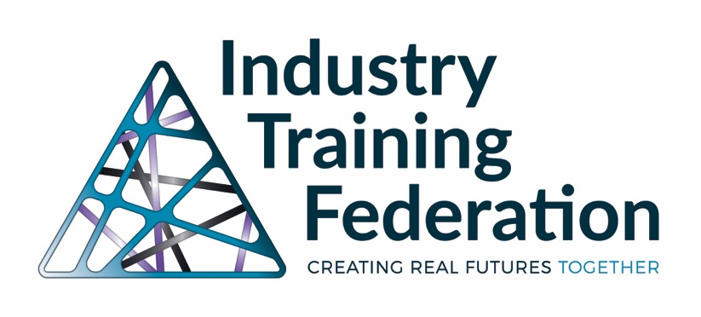
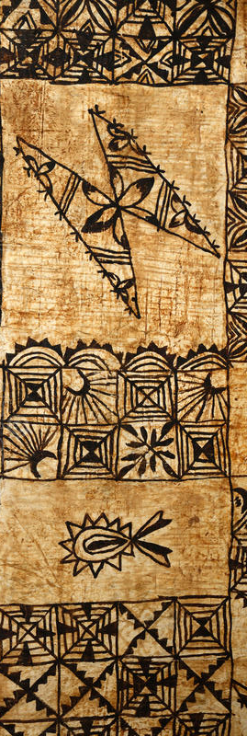
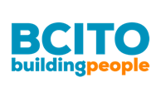



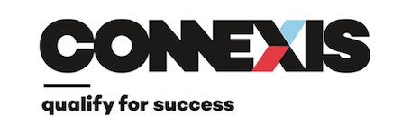







Industry Training in New Zealand
d
Notes:
Talitali fiefia, Malo e lelei
Malo le soifua manuia. O te fa’atalofa atu ia le Paia mā le mamalu o le tatou Mafutaga
Warm Pacific Greetings to you all.
O lo’o igoa o Laloifi Ripley NZ born Samoan.
My parents are first generators arriving in NZ in the early 1950’s.
My mother Alice is from the villages of Matatutu –Tai and Sapunaoa Falealiili I Samoa
And my father Ned is from nuu of Leone I Pago Pago Amerika Samoa.
I work for CF and have been succonded to the ITF to work on the Hinatore research project. I am very fortunate to be working with Ann Alkema who is very well known in this space and Nicky Murry as the Programme Manager for the Research.
I am the Pasifika Lead for the project and Cain Kereoma is the Māori Lead for this work.
Ann to speak/introduce

Slide 2
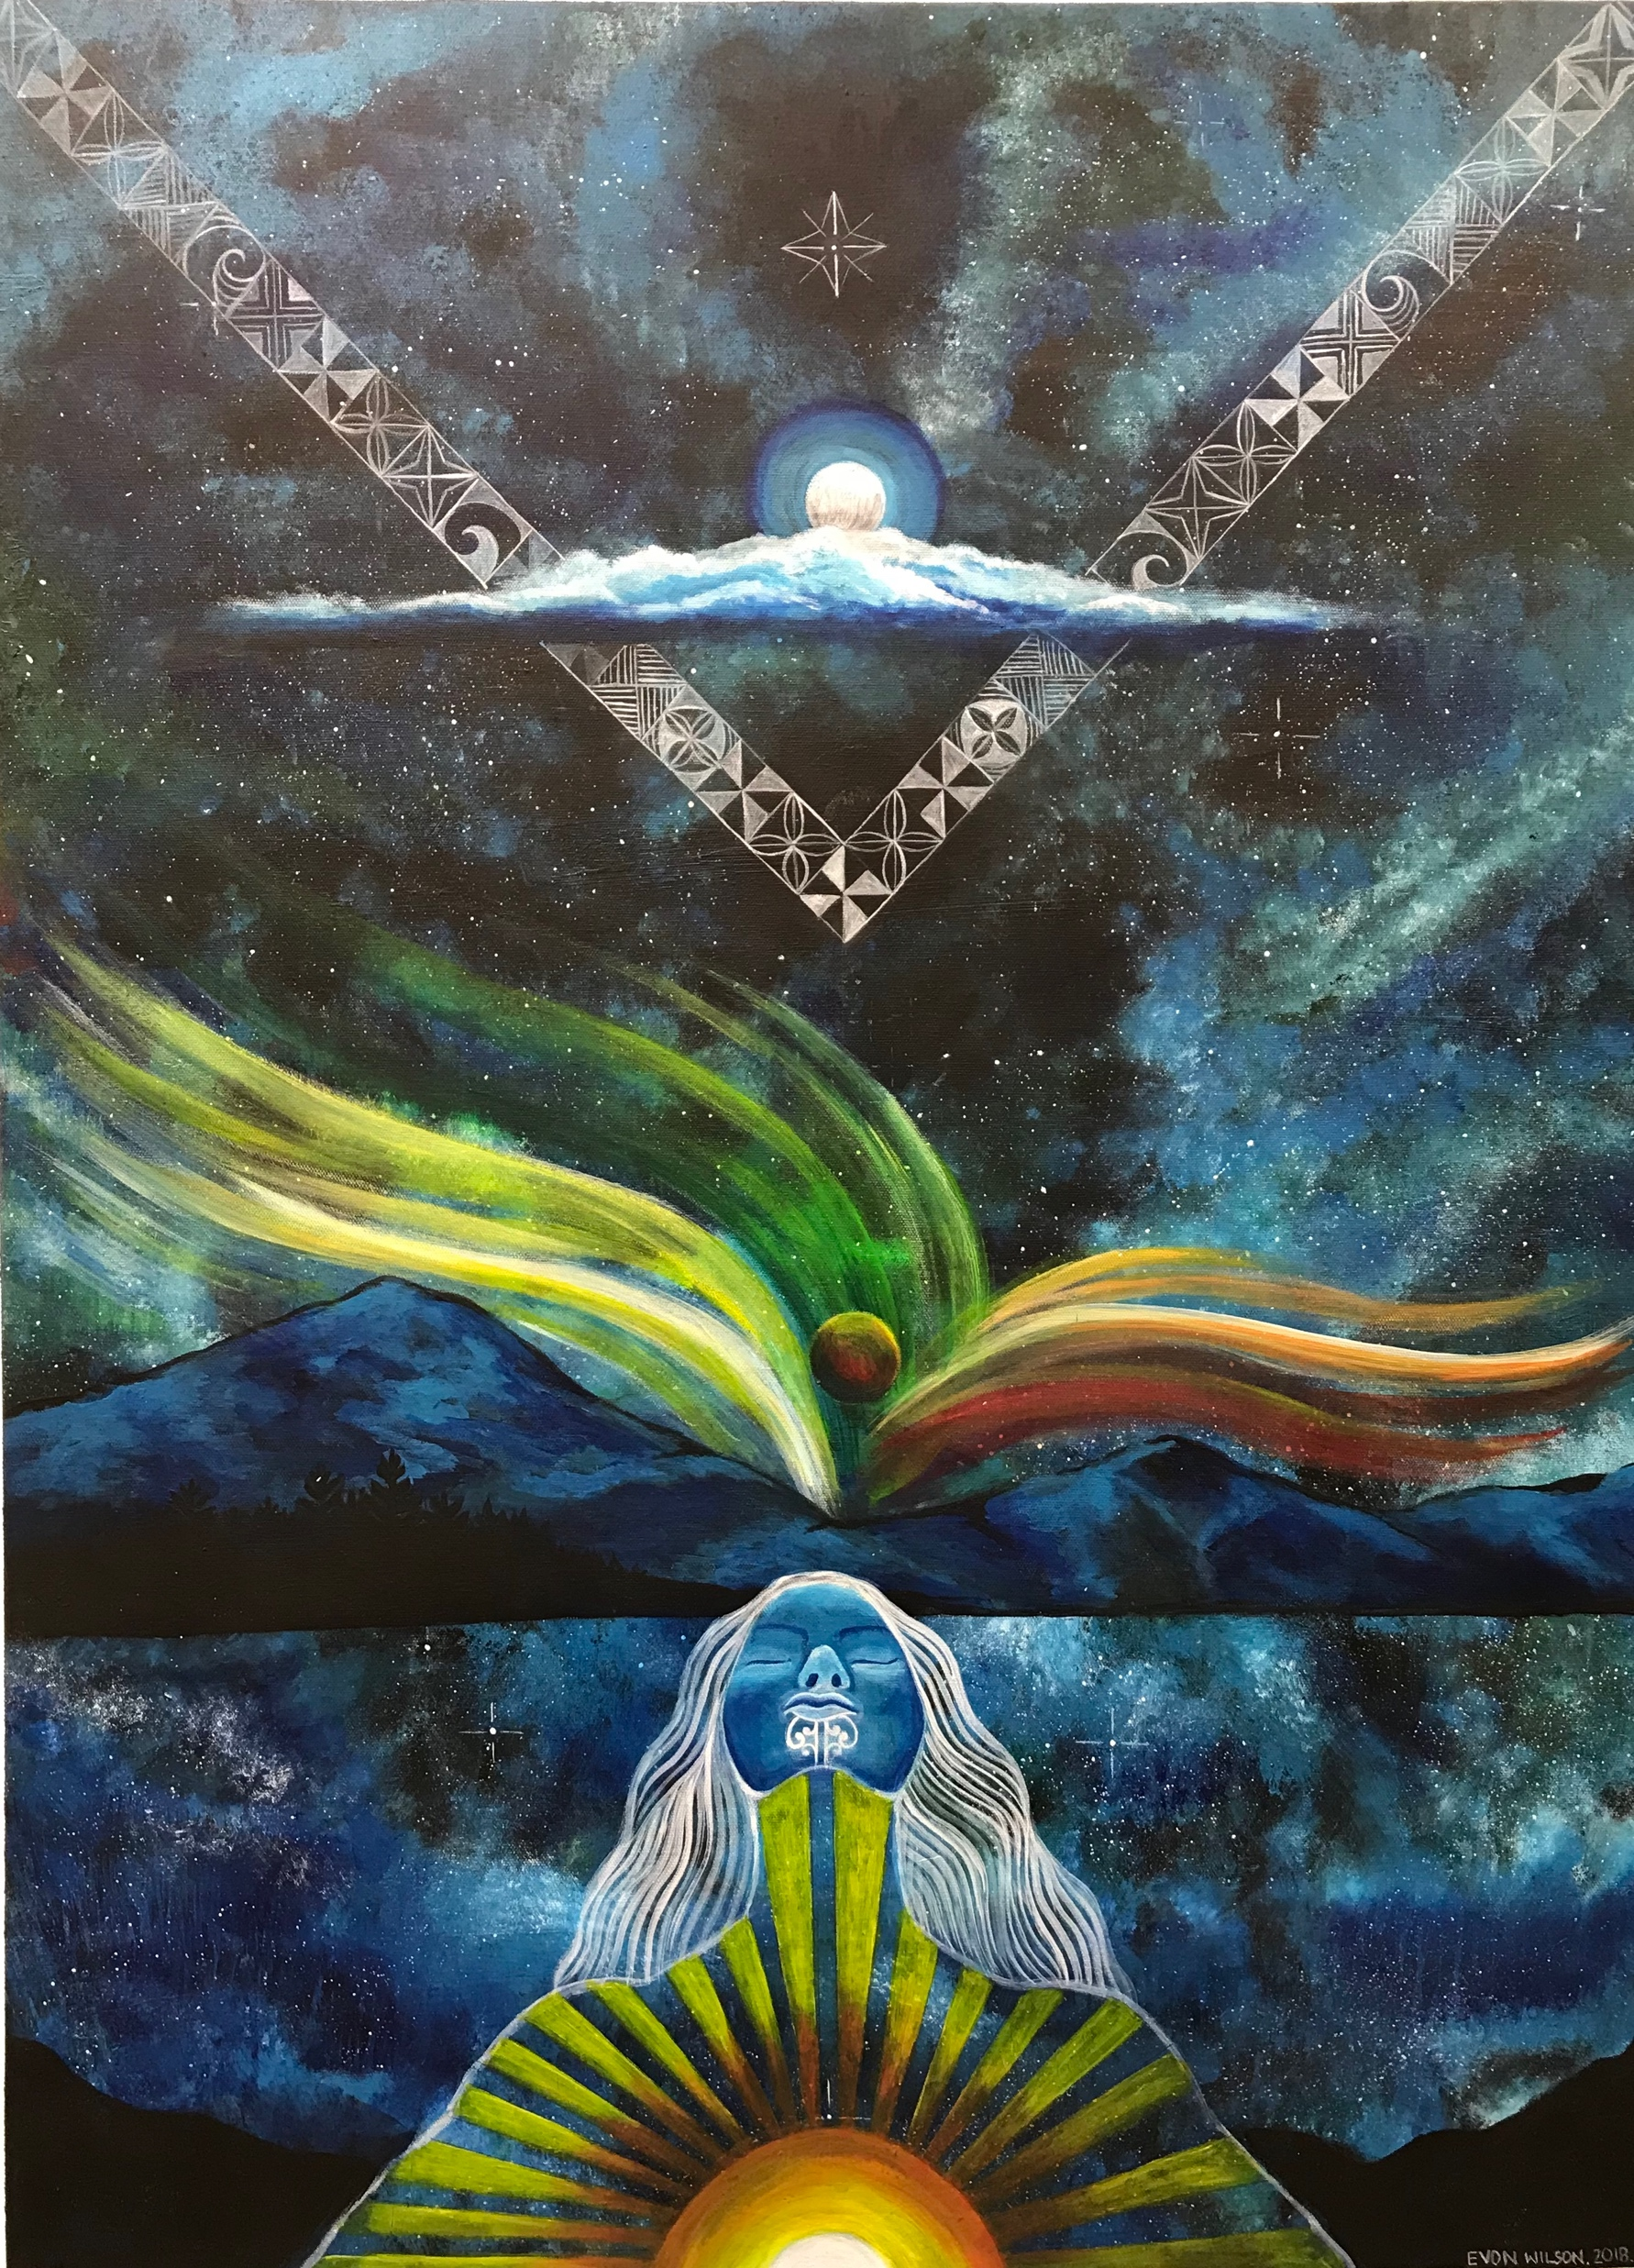
Informing Practice:
Hīnātore
Literacy is an empowerment tool, opening up new potential, new light. It is a glimpse at ‘possibility’ that can inspire new learning and new growth.
SKILLS HIGHWAY
Notes:
The painting tells the story of Hīnātore (pronounced he-nah-tor-re), which means phosphorescent light. In Māori mythology, when Ranginui (Sky father) and Papatuanuku (earth mother) were separated by their children, the first glimmer of light was Hīnātore. While the light was feeble and distant, it drove Tane’s ambition to bring more light to heaven and earth. He sought about procuring and distributing Te Whanau Marama - stars, moon, sun – to fill the world with light. Thus Te Ao Marama, the realm of light, this light-possessing world, came into being.
The story of Hīnātore relates to our mahi in that literacy is an empowerment tool, opening up new potential, new light. It is a glimpse at ‘possibility’ that can inspire new learning and new growth.
The light is also dynamic - changing colours and shapes as different forces collide. This is an apt description of the dynamic nature of learning and growth.

Slide 3
Informing Practice: Māori and Pasifika employees
Co-funded by Ako Aotearoa and the Industry Training Federation
What we know: Māori and Pasifika employees engage in workplace programmes
What we don’t know: what causes them to re-engage with learning
Methods: to find out what is happening in the ‘black box’ of the classroom:
  Engaged Māori and Pasifika researchers
  Observations by researchers (early, during and end of programmes)
  Tutors as researchers – gathering evidence of impact of their practice
  Interviews with employees and employers
  Sense making workshop with learners
Using social media
  To engage tutors in a community of practice as teachers and researchers
  Wanted to engage learners also – but this is not quite working yet
Notes:
Ifi/Anne

Slide 4








Context: Workplaces
Notes:
Literacy Providers that we are working with are:
Education Unlimited
Edvance
Languagues International
Learning Wave

Slide 5
Context: Workplace Literacy and Numeracy programmes
  Funded by the TEC
    25-80 hours learning
    around 7000 employees a year
    programmes delivered in workplaces in worktime and employees are paid
    Around a third of these employees are Māori or Pasifika
Notes:
Progress to date:
Reference Group
Training sessions with Tutors – awareness
Going into the workplaces and observing the lessons beginning/middle/end
Capture the how? What? Transferable skills etc.

