Slide 1
Skills and opportunities for industry
Derek Tunui and Samantha McNaughton

Slide 2
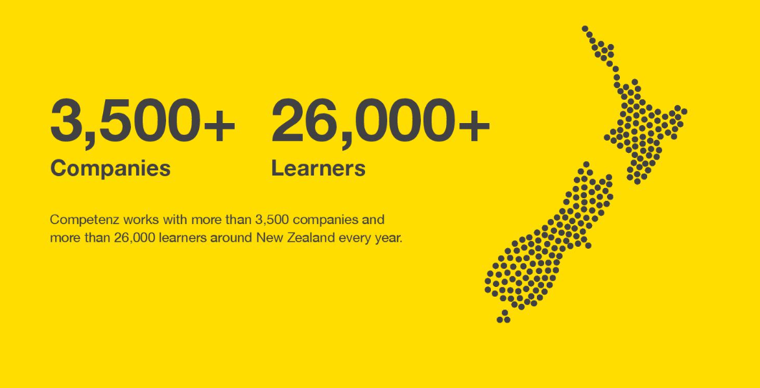
Notes:
We work with over 3,500 businesses and more than 26,000 learners every year.

Slide 3
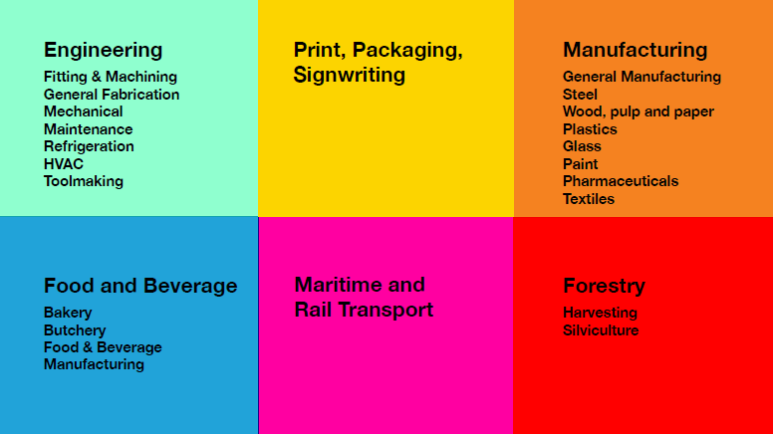
Gazetted coverage

Slide 4
Training programmes and apprenticeships
Gateway
  Butchery
  Bakery
  Engineering
  Forestry
  Furniture making
  Competenz apprenticeship
  ATNZ (Apprentice Training New Zealand).

Slide 5
Challenges facing our sectors
general manufacturing
general engineering
Now
2022
650
Additional people to support the mechanical engineering sector in 2018
1,200
Additional people to support the general manufacturing sector in 2018
20K+
Needed in the next
five years
Notes:
Competenz is the standard setting body for 36 sectors – ranging from engineering, manufacturing to forestry and rail. We support the country’s most productive sectors, and we know that our businesses are facing similar challenges.
Challenges such as how to respond to increasing pressure of skills shortages, talent pipelines, and retention or reskilling to respond to technological innovations and the aging workforce.
The engineering and manufacturing sectors are in growth mode and this is not only putting pressure on the existing workforce – i.e. the need to replace those exiting the workforce (predominantly due to aging), but we need to urgently find NEW people to fulfil NEW jobs
This year alone the mechanical engineering sector will need 650 people to fill NEW jobs; the general manufacturing sector needs more than 1000. Over the next five years, these two sectors need more then 20,000 people to need to demand for new jobs and replace those existing the workforce. That’s 23% of the workforce!

Slide 6
The current workforce
45%
No post-school qualifications
Retention
Productivity
Knowledge transfer
Health and safety
Competitive advantage
25%
Aged 55+
Value of
training
Diversity
Opportunity: 75%+ of the
workforce male European
Notes:
Almost half of our workforces have no post-qualifications. Post school training and formal qualifications ensure that our workforce has the skills needed to not only the job today, but anticipate and respond to the changes of tomorrow.
The average age of your workforce is about 44 years – and this is based on the 2013 Census. Five years ago 25% of your workforce was aged 55+ this portion of your workforce is now starting to retire.
The majority of the workforce comprises older male Europeans.
There is an opportunity to diversify your workforces by promoting to people that might not usually consider a career or career pathway.
We know that the value of having a trained and qualified workforce is:
Improved retention and attraction, as well as staff engagement – qualifications provide a sense of value and achievement, especially to those that have not achieved qualifications in the past.
A qualified workforce tends to be more efficient and productive – output tends to be of a higher quality
Qualifications develop a whole suite of skills ranging from technical to non-technical. They often include transferable skills that can further benefit the individual in their work and personal life, as well as benefit the business by ensuring all start are operating at the same, consistent standard
Qualifications cover critical health and safety aspects required of the work and the workplace.
Qualified staff can increase your competitive advantage, as well as your ability to attract new people
We know that there is no better time to train than now:
More than 700 people are needed every year for the next five years to replace those leaving the industry – these people need training/upskilling, etc… We know the sector has a slightly older age profile than the broader economy and is likely the primary reason for the large number of people needed.
GDP per FTE (a proxy for measuring productivity) is lower than the NZ workforce generally. It’s also lower than general manufacturing of $104k…. We’re noticing that workforces that tend to have more qualifications (at any level) tend to be more “productive” - i.e. a higher per FTE value.
We actively scan the environment to ensure our training programmes reflect industry standards and keep pace with changing systems, practices and technology.
The new Government has also provided a greater focus on tertiary education, through it’s fees free policy. I’ll discuss this in more detail later, but first I just want to introduce to Competenz….

Slide 7
Representation of Maori in Competenz-related sectors
Sector | % of entire sector (2013) | % of all Competenz learners (2017) | % of all Competenz L4+ learners (2017)
Forestry | 30% | 38% | 36%
Woodman | 24% | 41% | 41%
Retail meat | 14.7% | 18% | 20%
Food and beverage | 14.6% | 19% | n/a
Rail | 15.4% | 7% | 8%
All 36 Competenz sectors | 12.5% | 21% | 20%

Slide 8
Representation of Maori in Competenz-related sectors (growth needed)
Sector | % of entire sector (2013) | % of all Competenz learners (2017) | % of all Competenz L4+ learners (2017)
Mechanical engineering | 11.1% | 13% | 13%
Fabrication | 10.3% | 15% | 15%
RAC | 8.2% | 10% | 10%
HVAC | 8.2% | 18% | 17%
General manufacturing | 9.1% | 21% | 17%
Total Learners in Competenz |  | 21% | 19.5%

Slide 9
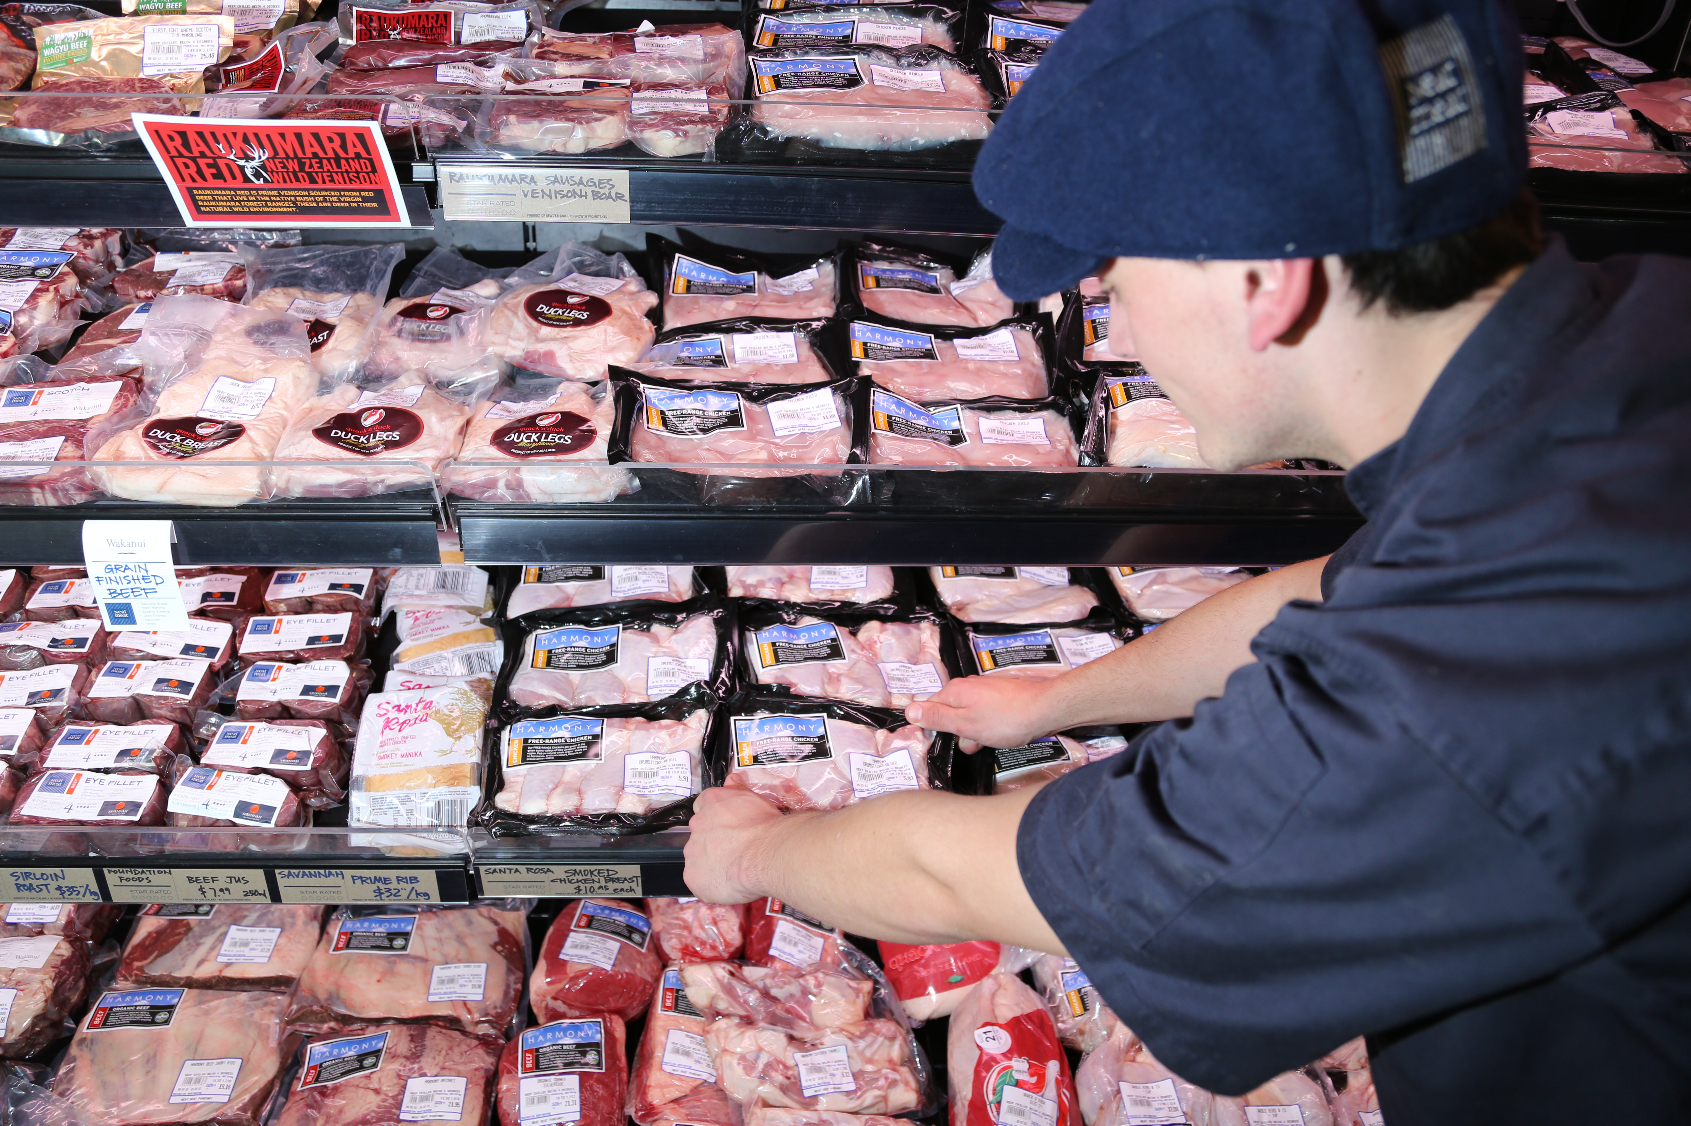
Thinking beyond tomorrow
Notes:
As we know, New Zealand is in boom time – unemployment is low, and our production sectors are growing. Our country and, more critically, our workforces are aging and there are tens of thousands of people exiting the workforce every where. In addition, sectors are competing for labour – we just need to look in our backyard: workers are carving out careers in construction, manufacturers are needing more people to produce more things to export, our new Government wants to plant One Billion Trees by 2028 – that’s twice the capacity than currently projected. All of these sectors need people, and they are all drawing from the same pool.
New Zealand’s manufacturing industry is growing, and unfortunately, the negative consequence of growth is the skills shortage. The workforce is also aging and technology is fast changing what we do, who does it and how it’s done.

Slide 10
A culture of on-going learning is needed
“From our youngest high school graduates to our most experienced governance leaders we all face the undeniable truth that things aren’t as they used to be. Our current capacity is based upon the sum of all that we have experienced to date. Our future capacity will be based on the additional input, insight and addition of everything we are yet to discover.”
Frances Valintine, 2018
Founder at Tech Futures Lab and The Mind Lab
https://www.linkedin.com/pulse/what-your-future-state-frances-valintine-cnzm-/
Notes:
A wonderful article recently published by Frances Valintine noted the current challenges facing all workforces, but also outlined that the focus is shifting. The pure focus on technology is now shifting to an organisation’s most critical asset – its people.
Workforce diversification is an essential conversation not only to meet the skills shortage challenges of the next five year, but to meet the changing requiremenets of the indsutry, technology and pace of work.

Slide 11
CZ Strategy for Maori and Pasifika
  Increasing participation of Maori learners in Competenz:
  Schools engagement
  Maori and Pasifika Trade Training
  Community engagement
  Iwi engagement.
Notes:
Increasing participation of Maori learners into Cz programmes delivers on one of TECs key strategies – Pri 3: Boosting Maori Achievement

Slide 12
Competenz strategy for Maori and Pasifika
  MPTT
  Schools visits
  Iwi engagement
    TWoA-led Forestry cohort,
    Te Pae Tawhiti (Sth Island Roadshow).

Slide 13
Current opportunities
  Auckland schools
  Iwi (Waikato Tainui and Ngai Tahu)
  Primary ITO led research project on contextualised learning.

Slide 14
Future opportunities
  Primary ITO-led research project into contextualised learning
  Forestry
    Government focus e.g. one billion trees
  Ruakura Inland Port (Waikato Tainui)
  Te Pae Tawhiti (Ngai Tahu).

Slide 15
Future opportunities
  Sectors in growth:
    Mechanical Engineering
    Manufacturing
    Food and beverage
    Fabrication
    RAC / HVAC
Notes:
There is a government focus on forestry and regional economic development (e.g. 1BT)
Mech engineering while only experiencing moderate growth is one of biggest sectors and for the forseeable future will continue to need significant support to sustain it
Manufacturing is one of our largest sectors and has been in growth since 2010
Food and Bevearge like Mech engineering has only experienced moderate growth in recent times but is another of our larger industries and will need support to sustain its sizeable requirement
Fabrication has strong growth which has been consistent since 2010

Slide 16
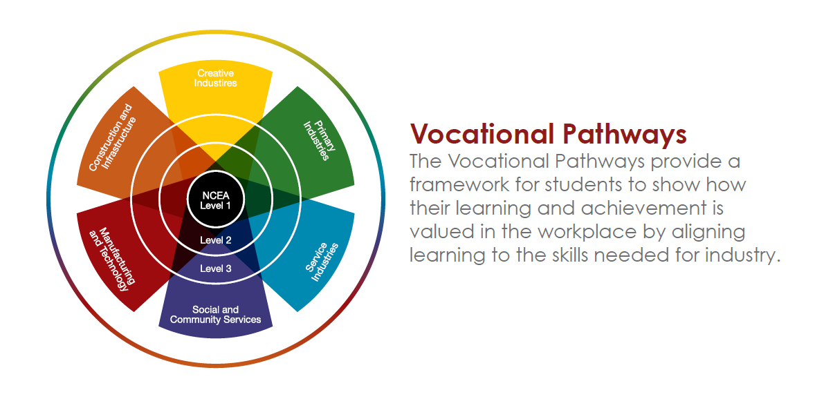

Vocational pathways
Notes:
We know that the butchery workforce is marginally younger than the general labour market, although you are still facing the same challenges around an aging workforce, your replenishment workforce is much younger!
Almost two-thirds of the workforce has no post school qualifications, so exposing people to your existing sector at sector through school is critical.
We know that more than 70% of school students do not go to university, yet, until recently much of the school curriculum focused on pathwaying people into academia. Five years ago, the government implemented vocational pathways. This enable the formal recognition of critical industry skills at school to better pathway young people into sustainable careers, where critical labour is urgently needed.
This year we launched a gateway programme – that is a programme where NCEA students can learn trade-specific skills and gain crucial until standards to set them up on the pathway for a career in your industry. We are working with organisations to pilot this initiative.
The programme includes five unit standards that pathway into our Level 3 or 4 qualifications and provide a great overview/taster for the industry. We facilitate a one-day a week work placement for 10 weeks to enable them to gain critical exposure to industry operations. It’s basically a 10-week job interview and we support learners with workplace visits and assessment.
Last year we had 16 students engaged in the programme, and already we have 9 with the expectation this will grow to 29 in the next two school terms. At the end of the programme the learner and employer can then make very informed decisions about whether they will progress in the indsutry or with that employer.

Slide 17
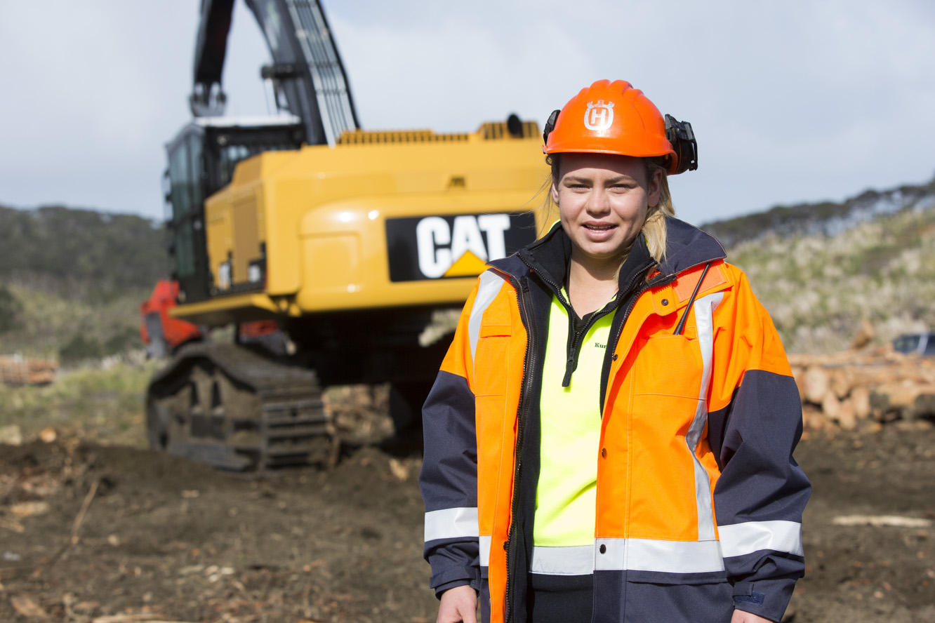
One billion trees
Notes:
As we know, New Zealand is in boom time – unemployment is low, and our production sectors are growing. Our country and, more critically, our workforces are aging and there are tens of thousands of people exiting the workforce every where. In addition, sectors are competing for labour – we just need to look in our backyard: workers are carving out careers in construction, manufacturers are needing more people to produce more things to export, our new Government wants to plant One Billion Trees by 2028 – that’s twice the capacity than currently projected. All of these sectors need people, and they are all drawing from the same pool.
New Zealand’s manufacturing industry is growing, and unfortunately, the negative consequence of growth is the skills shortage. The workforce is also aging and technology is fast changing what we do, who does it and how it’s done.

Slide 18
Overview of the forestry sector
  300+ newly created jobs annually to 2021 500+ replacement jobs
  0.8% Contribution to GDP
Diverse and aging workforce:
  30% Maori
  23% female
  43% aged over 45 years
Geographic spread – concentrated in Bay of Plenty, Waikato, Auckland, Northland and Canterbury
Notes:
Following a decline in recent years, employment in the sector is set to increase in the next five years. The industry needs to find:
300+ newly created jobs annually to 2021; 500+ replacement jobs
Highly productive sector –
GDP per FTE : $173K cf. $108K for the broader economy
0.8% contribution to GDP
Diverse and aging workforce:
30% Maori
23% female
43% aged over 45 years
Comprises a significant number of independent contractors (84% of people are self-employed)
Remote regional geographic spread – concentrated in Bay of Plenty, Waikato, Auckland, Northland and Canterbury
What we know about the Forestry Sector – Mark
Cz utilizes Infometrics data as well as industry information gathered at industry conferences and via industry updates (e-newsletters) to understand history and trends
Collaborating with industry stakeholders to develop skills development strategy - via the FOA Training and Careers Committee, FICA action groups
Change in industry structure
Industry history
Originally the government, through the forest service, managed the majority of forests, Used employees as workforce. Arranged all training in-house and through the likes of the Woodsman school
Then from late 80’s up until late 90’s there were 3 main forest owners. They moved workforce from employees to a contractor based system. Originally the companies provided training services to the contractors, but this was slowly removed, giving responsibility to contractor.
Since then the industry structure has changed dramatically with forest ownership being spread across dozens of owners (or managers when the owner is an overseas entity, like a pension fund). More and more emphasis was put on margin, and therefore contractors rates got squeezed. One of the costs that took a hit was training. Many contractors train in-house to manage this cost while still meeting a compliance requirement (competent for task)
New HSW legislation has put additional onus on the contractor and also the forest manager, and therefore we have seen an increased interest in formalized training and assessment

Slide 19
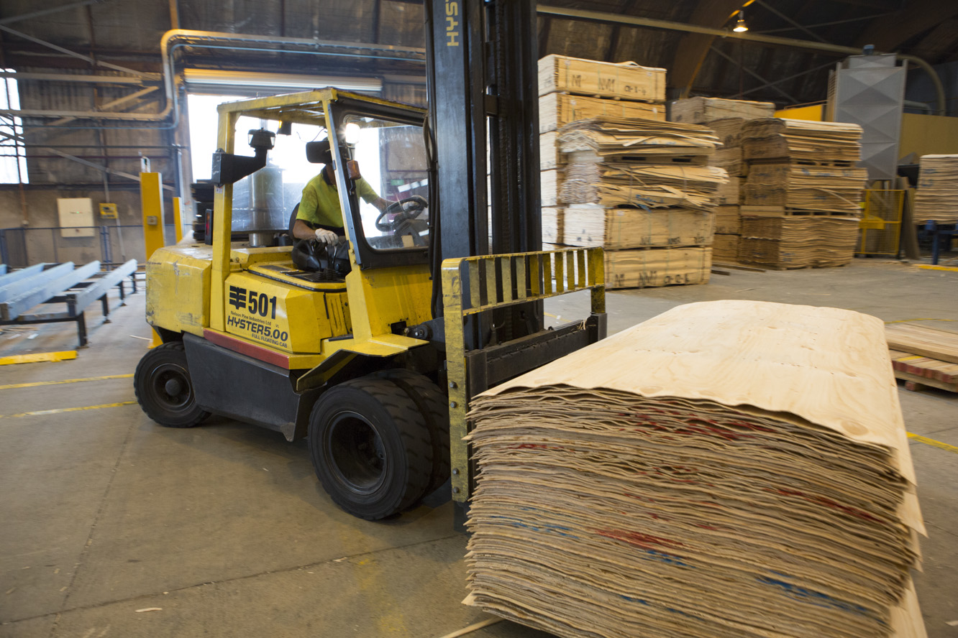
Overview of the forestry sector
Mechanisation is changing the nature of work
We know that more and more people are needing soft-skills training
Government investment in forestry – re-establishing the forestry service, and planting one billion trees.
Notes:
Mechanisation is not new to the forestry sector, however there has been a concentrated effort in recent years with Future Forests Research, now Forest Growers Research, focusing on reducing the number of people doing manual operations – ‘no man on the ground, no hand on the saw’. This initiative originated and gained additional support as a result of the Independent Forest Safety
Mechanisation is changing the nature of work
We know that more and more people are needing soft-skills training
Government investment in forestry – re-establishing The Forestry Service, and Planting 1 Billion Trees
Lots of regional investment and initiatives underway – e.g. supporting people into work, career pathways, and cross-industry collaboration
Strong media attention
Review after a high number of fatalities in 2013
We have worked with FGR as new operations have developed and are about to release new unit standards on ‘cable assist harvesting’ allowing machines to work on steep terrain
Soft skill training has gathered momentum over recent years. Forestry has long had a history of doing OSH type programmes, but there is more demand for leadership training – many crew leaders have been promoted into the role not because they have the right skills but because they have been there the longest.
Through the governments increased focus on forestry, there is an opportunity to enhance the image of forestry and bring new workers into the sector. These will be needed to plant the trees but it is also important to ensure they are well trained, and also see a career pathway in the sector.
As the industry introduced mandatory pre-employment and random drug testing, as well as a declining interest in forestry as a career, the numbers of people attending provider pre-employment courses decreased. In many cases to the point where courses are no longer offered. This disrupted the pathway into the industry. The new regional investment initiatives should see some of these courses resurrected. We are working with the likes of EWC and their proposed generation programme. The intention that people pathway into an apprenticeship

Slide 20
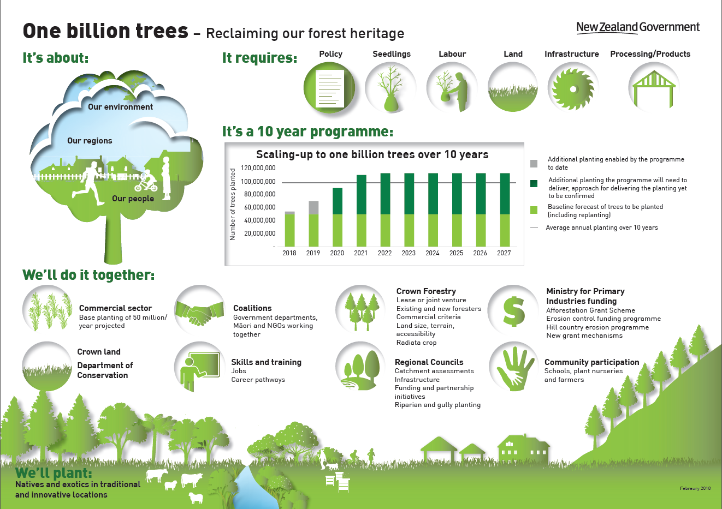
Overview of the forestry sector
Notes:
Mechanisation is not new to the forestry sector, however there has been a concentrated effort in recent years with Future Forests Research, now Forest Growers Research, focusing on reducing the number of people doing manual operations – ‘no man on the ground, no hand on the saw’. This initiative originated and gained additional support as a result of the Independent Forest Safety Review after a high number of fatalities in 2013
We have worked with FGR as new operations have developed and are about to release new unit standards on ‘cable assist harvesting’ allowing machines to work on steep terrain
Soft skill training has gathered momentum over recent years. Forestry has long had a history of doing OSH type programmes, but there is more demand for leadership training – many crew leaders have been promoted into the role not because they have the right skills but because they have been there the longest.
Through the governments increased focus on forestry, there is an opportunity to enhance the image of forestry and bring new workers into the sector. These will be needed to plant the trees but it is also important to ensure they are well trained, and also see a career pathway in the sector.
As the industry introduced mandatory pre-employment and random drug testing, as well as a declining interest in forestry as a career, the numbers of people attending provider pre-employment courses decreased. In many cases to the point where courses are no longer offered. This disrupted the pathway into the industry. The new regional investment initiatives should see some of these courses resurrected. We are working with the likes of EWC and their proposed generation programme. The intention that people pathway into an apprenticeship

Slide 21
What we know about our learners (2017)
3,404 learners in 2017
2,013
new enrolments in 2017
706 employers
59% credit achievement
48% programme completion
2% female
38% Maori
21% aged 16-24
72% female credit achievement
46% female programme completion
57% Maori credit achievement
43% Maori programme completion
59% youth credit achievement
27% youth programme completion
Notes:
Please refer to EPI spreadsheet for 2013-2018 comparison
Christine to discuss trends – Individual AM info on new dashboard
We’re involved in the Ako project – Mark to provide overview and background info….
Contract assessor network is diverse, reflecting the nature of the workforce.
Anything that Derek’s team doing? Gateway… (low uptake)
Low youth achievement: high turnover (external and internal – the good ones get moved within the crew to a different role), lead to increased completion time, more on the job training/intensive supervision required which can be challenging for contractors due to commercial constraints…

Slide 22

Meet Jaz Kuru – forestry and logging worker

Slide 23

Fees Free
Two years Fees Free for industry training
For eligible learners enrolling in eligible programmes
Covers fees paid by eligible trainees and their employers for training and assessment
Eligible qualifications are those that meet the 120-credit, Level 3 eligibility rule
FAQs here www.competenz.org.nz/jobseekers/two-years-free-industry-training/
We can check learner eligibility. Call 0800 526 1800.
Notes:
The government recently launched a new policy to support and encourage people into the tertiary education. The fees free initiative was launched on 1 Jan this year and there are a range of engineering and manufacturing apprenticeship programmes that are eligible.
Essentially the first two years of a person’s apprenticeship could be free provided the learner and selected qualification meets the eligibility criteria.
That’s the end of our presentation. There really is no better time to train. Come an speak to us at stand and we’re more than happy to take questions

Slide 24

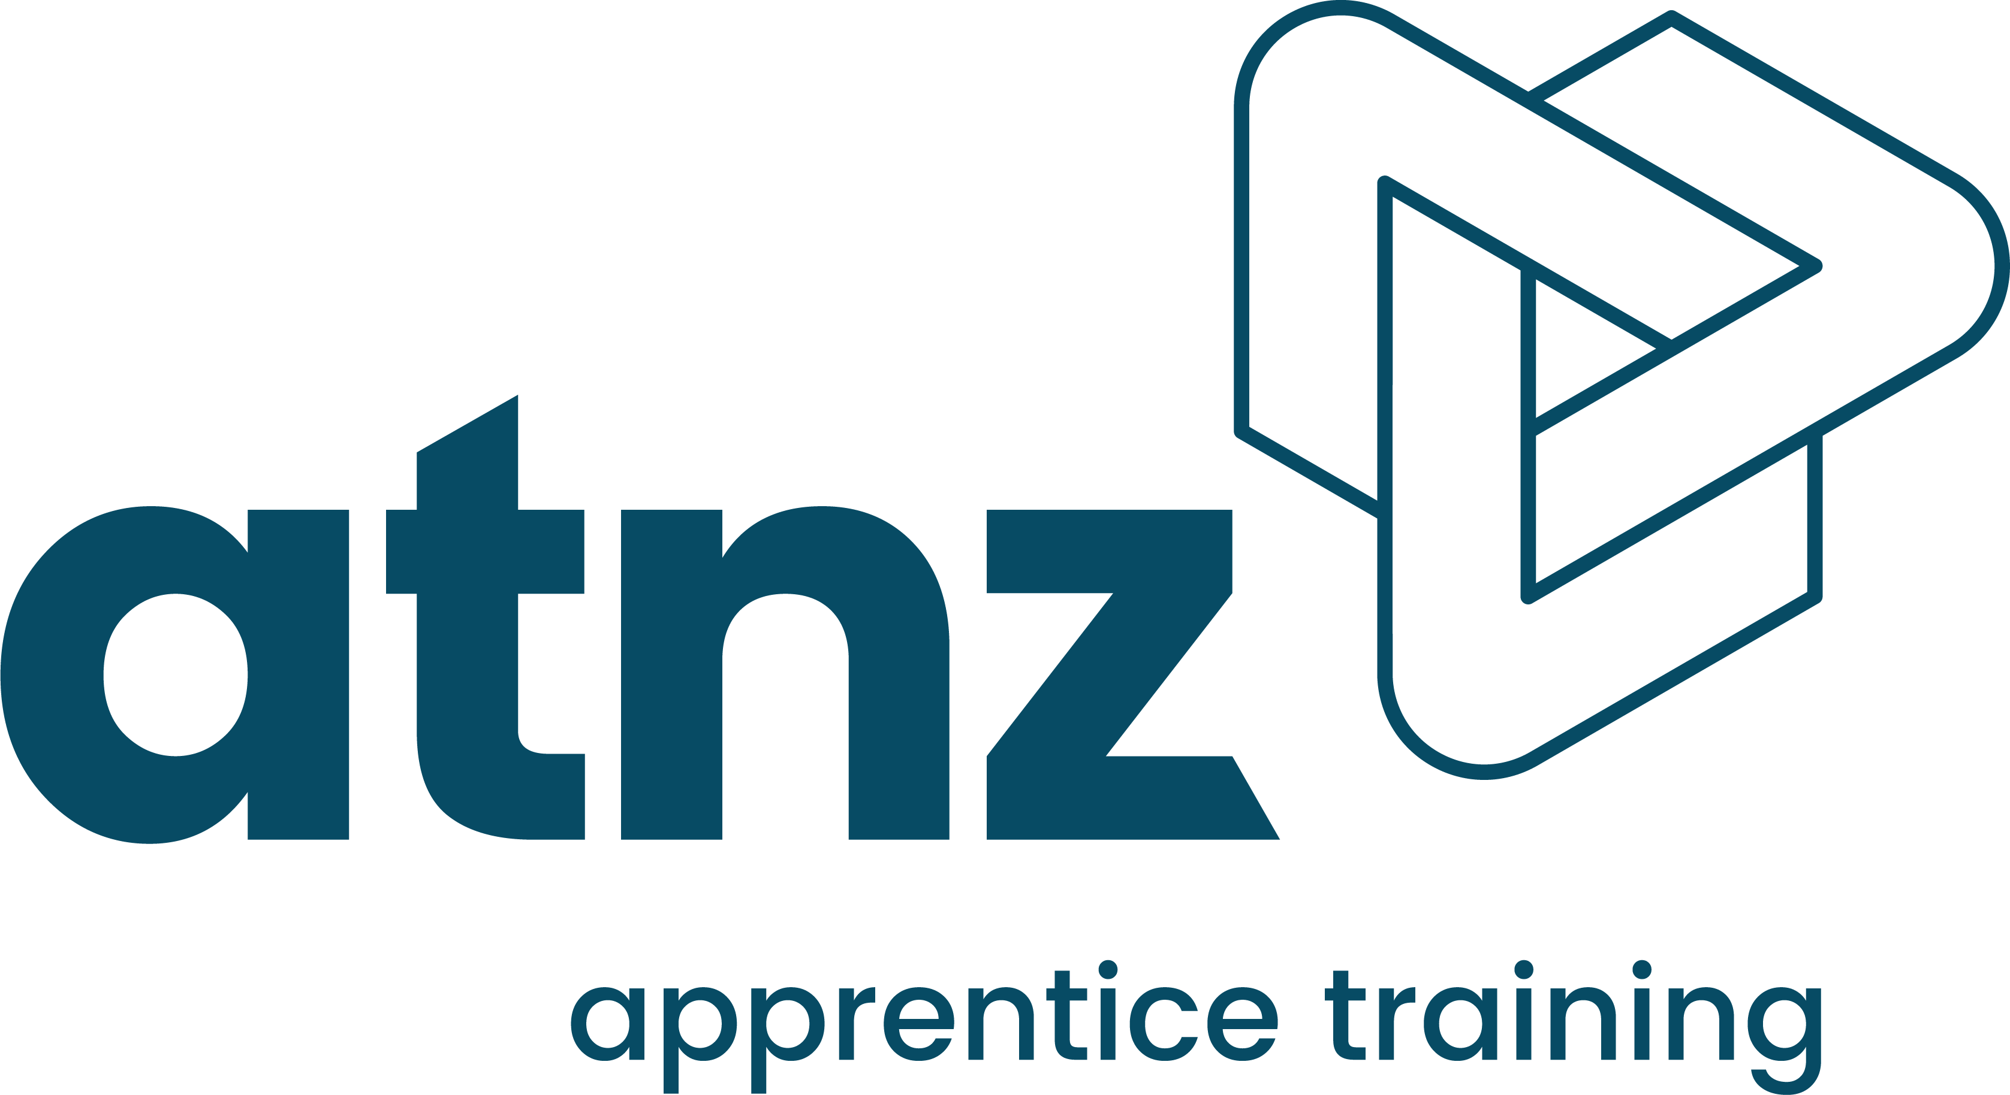


Resources
Notes:
We facilitate training for a range of nationally recognized and industry-endorsed qualifications including those that support the development of foundation/entry-level skills, technical apprenticeships, to business skills and team leadership.
We offer a range of tailored support options to best suit your business. This includes our Appetence Training NZ model whereby we recruit and employ your apprentice
We also offer a range of bite-sized learning solutions to support your people at any stage of their career.

Slide 25
Thank you

