Slide 1
He oranga haumako. He waaheke ranga wairua. Enriching lives, inspiring futures: Developing career pathways in an increasingly technological and digital world.
Kim Harris and Mark Lawrence
2 August 2018

Slide 2
SPEAKER
Kim Harris
Workforce Development Advisor, MITO

Slide 3
Our industries
Commercial Road Transport
Resource Recovery
Industrial Textile Fabrication
Automotive
Drilling
Gas
Mining and Quarrying
Passenger Services
Ports and Stevedoring
Warehousing and Logistics

Slide 4
Hari huritau e MITO!

Slide 5
Notes:
Answers
Maori New Year
A star cluster
May, June or July

Slide 6
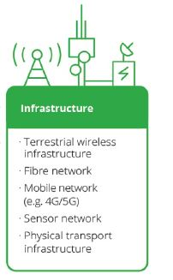
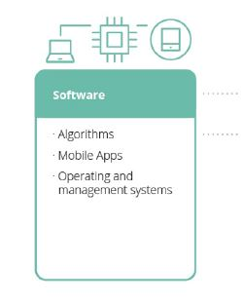
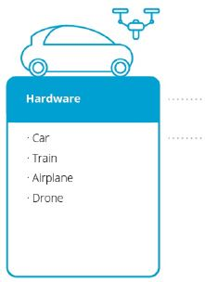
ITS – Intelligent Transport Systems

Slide 7
Autonomous Pods

Slide 8
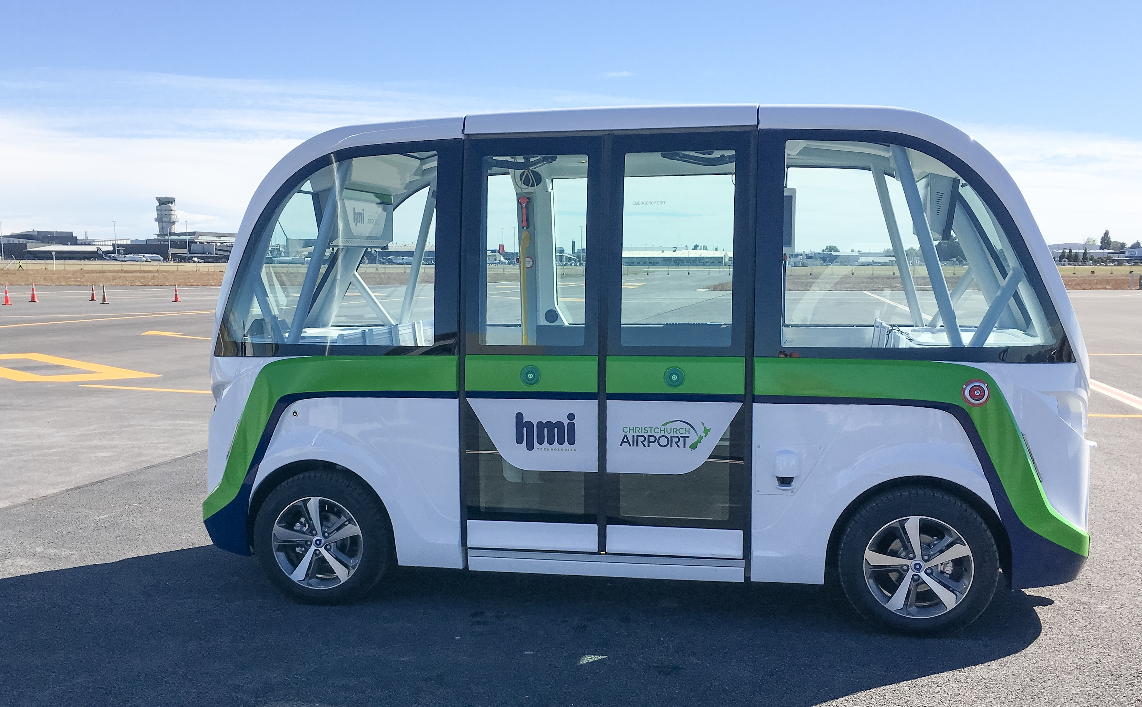
New Zealand’s first Smart Shuttle

Slide 9
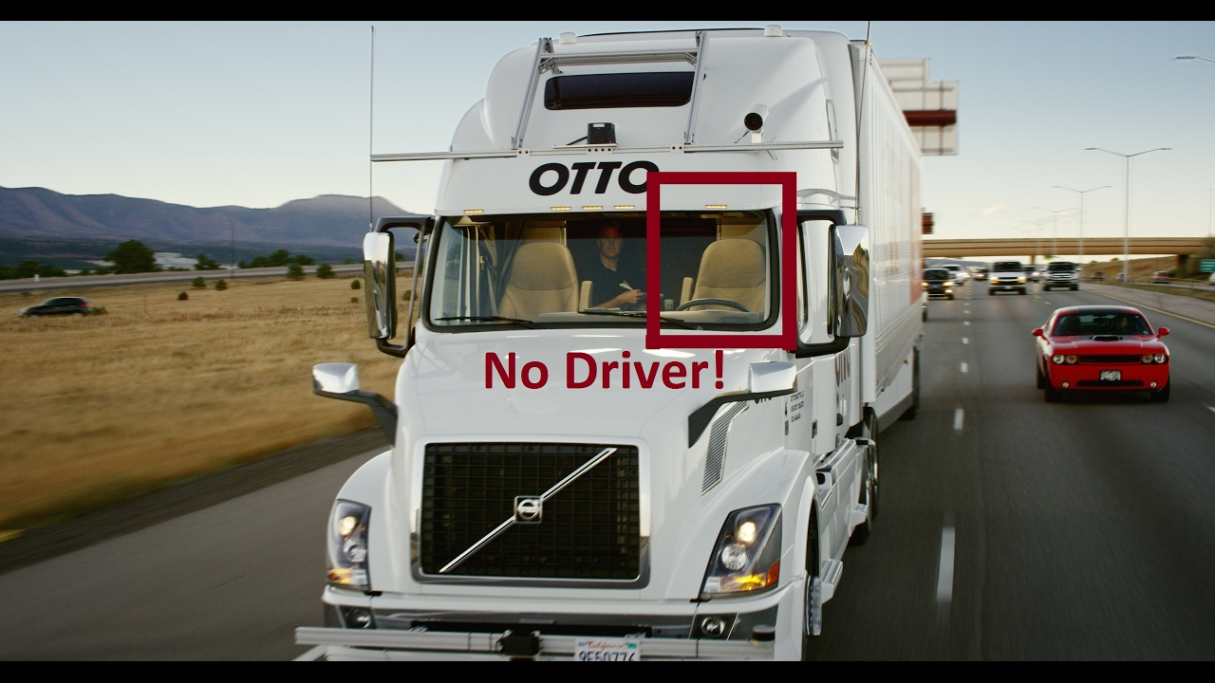
Autonomous trucks

Slide 10
Self driving trucks

Slide 11
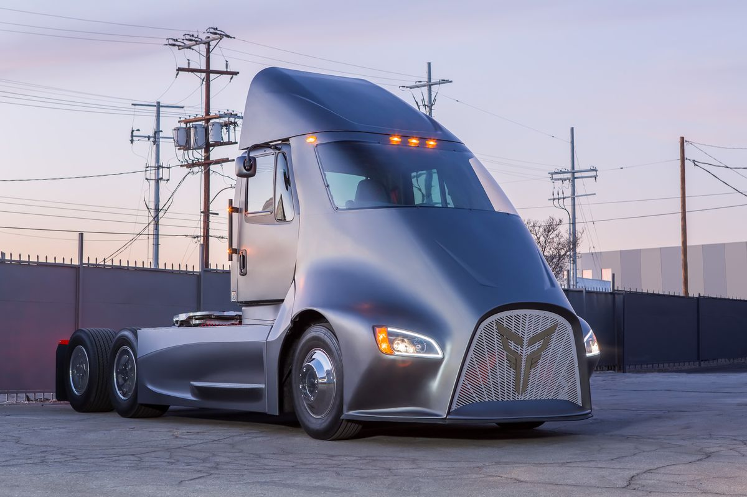
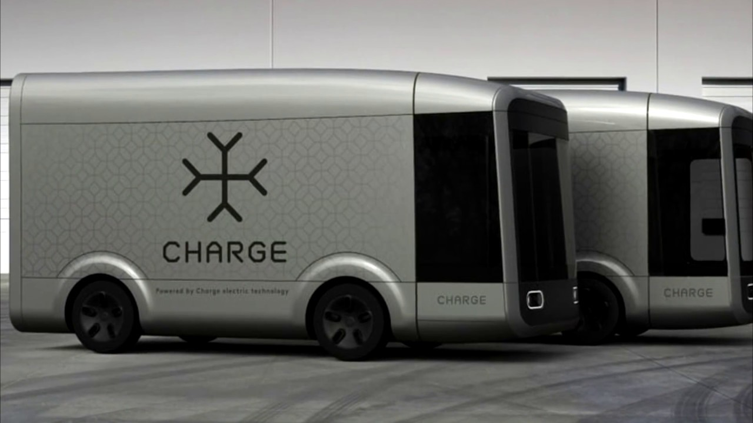
TRANSPORT
IS A TECHNOLOGY BUSINESS

Slide 12
SPEAKER
Mark Lawrence
Manager Corporate, MITO

Slide 13
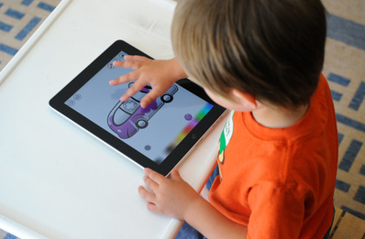
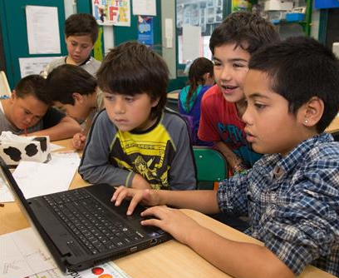

Slide 14
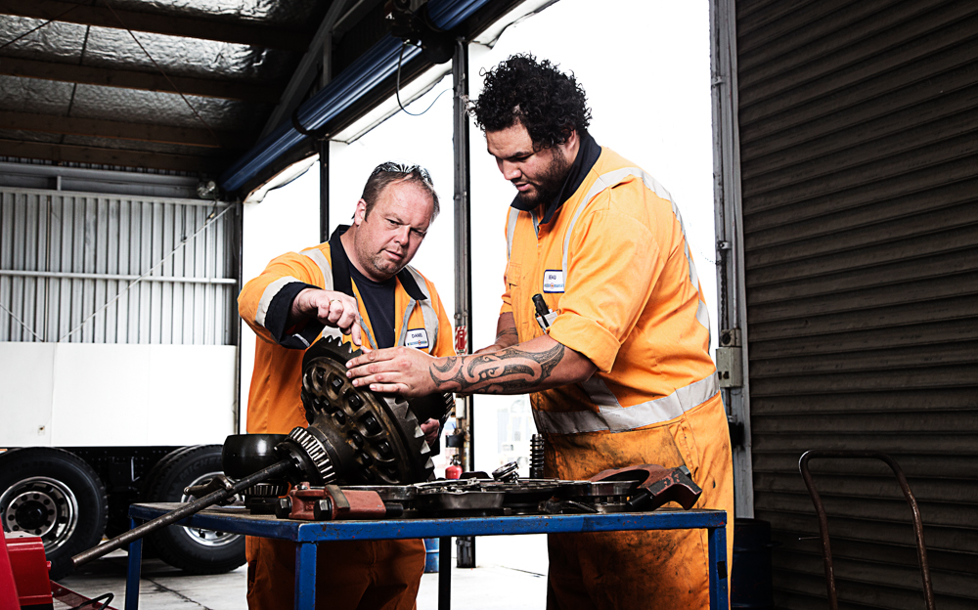
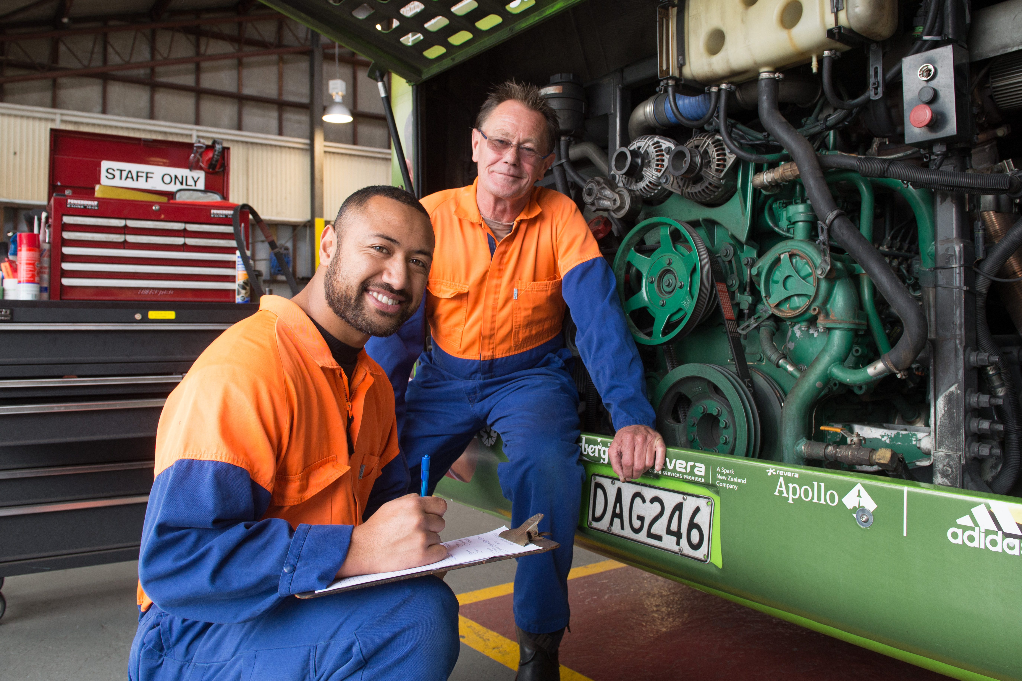
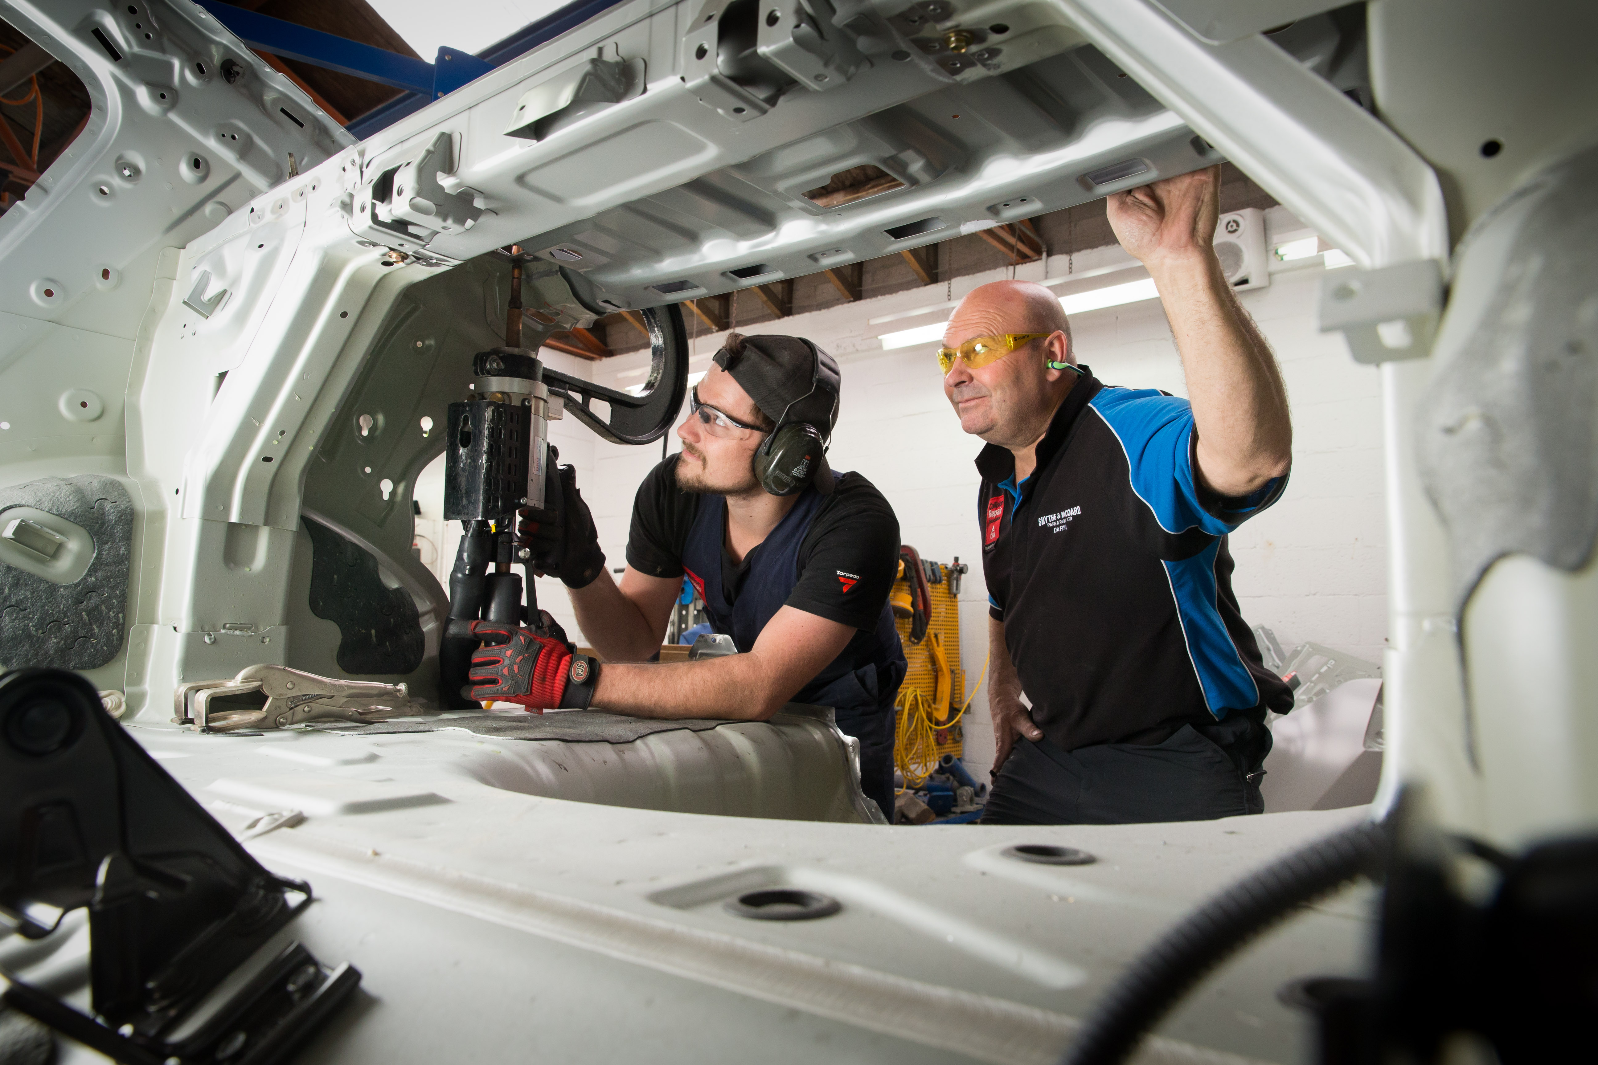
Learning on-the-job

Slide 15
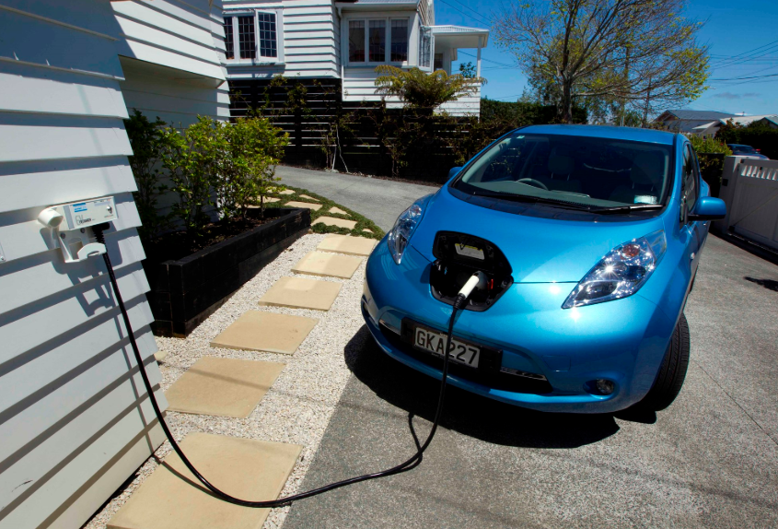
Evolving training to meet industry needs
EV qualification launching in
early 2019

Slide 16
Evolving training to meet industry needs
Automotive ‘mini-apprenticeship’ for secondary students in
Years 11, 12 and 13

Slide 17
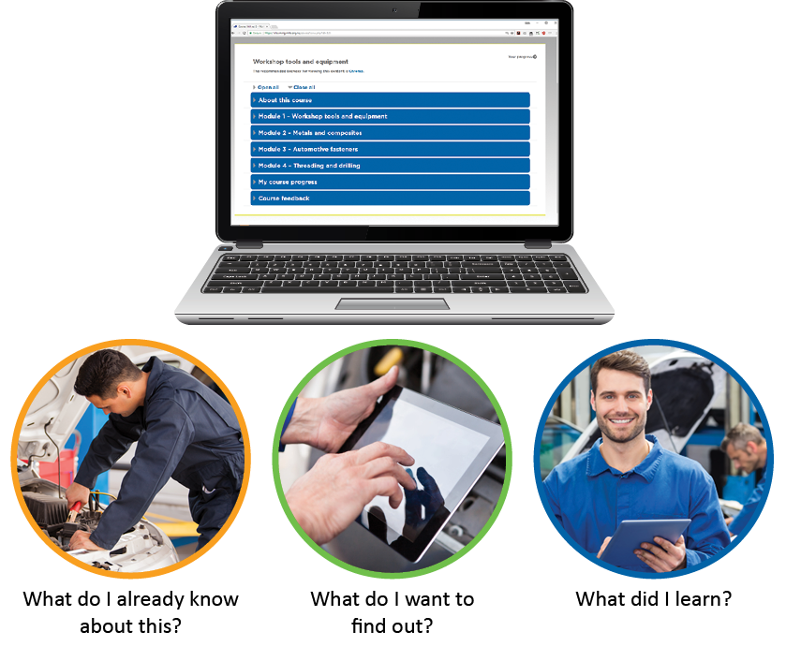
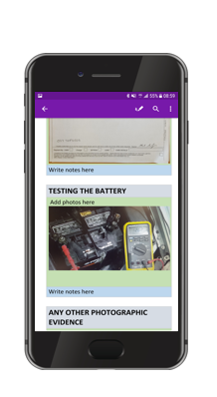
eLearning

Slide 18
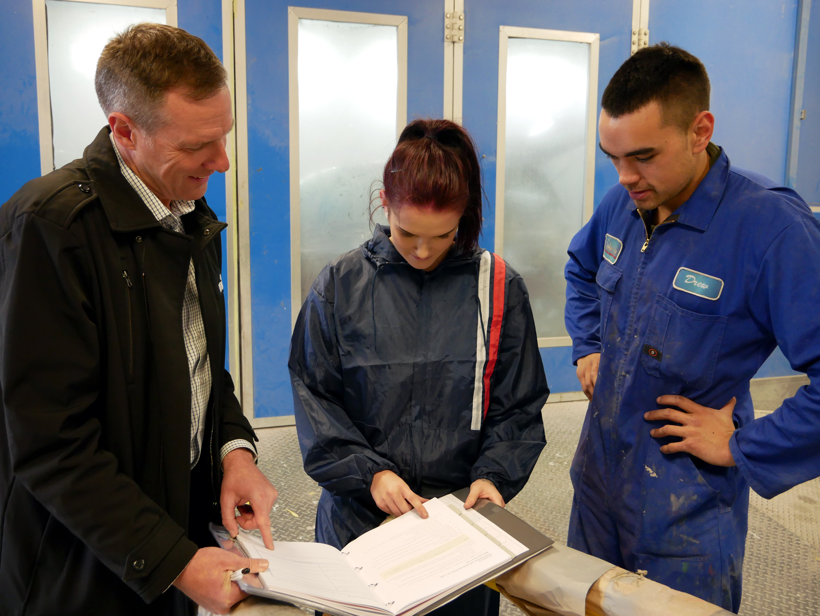
Supporting our learners

Slide 19
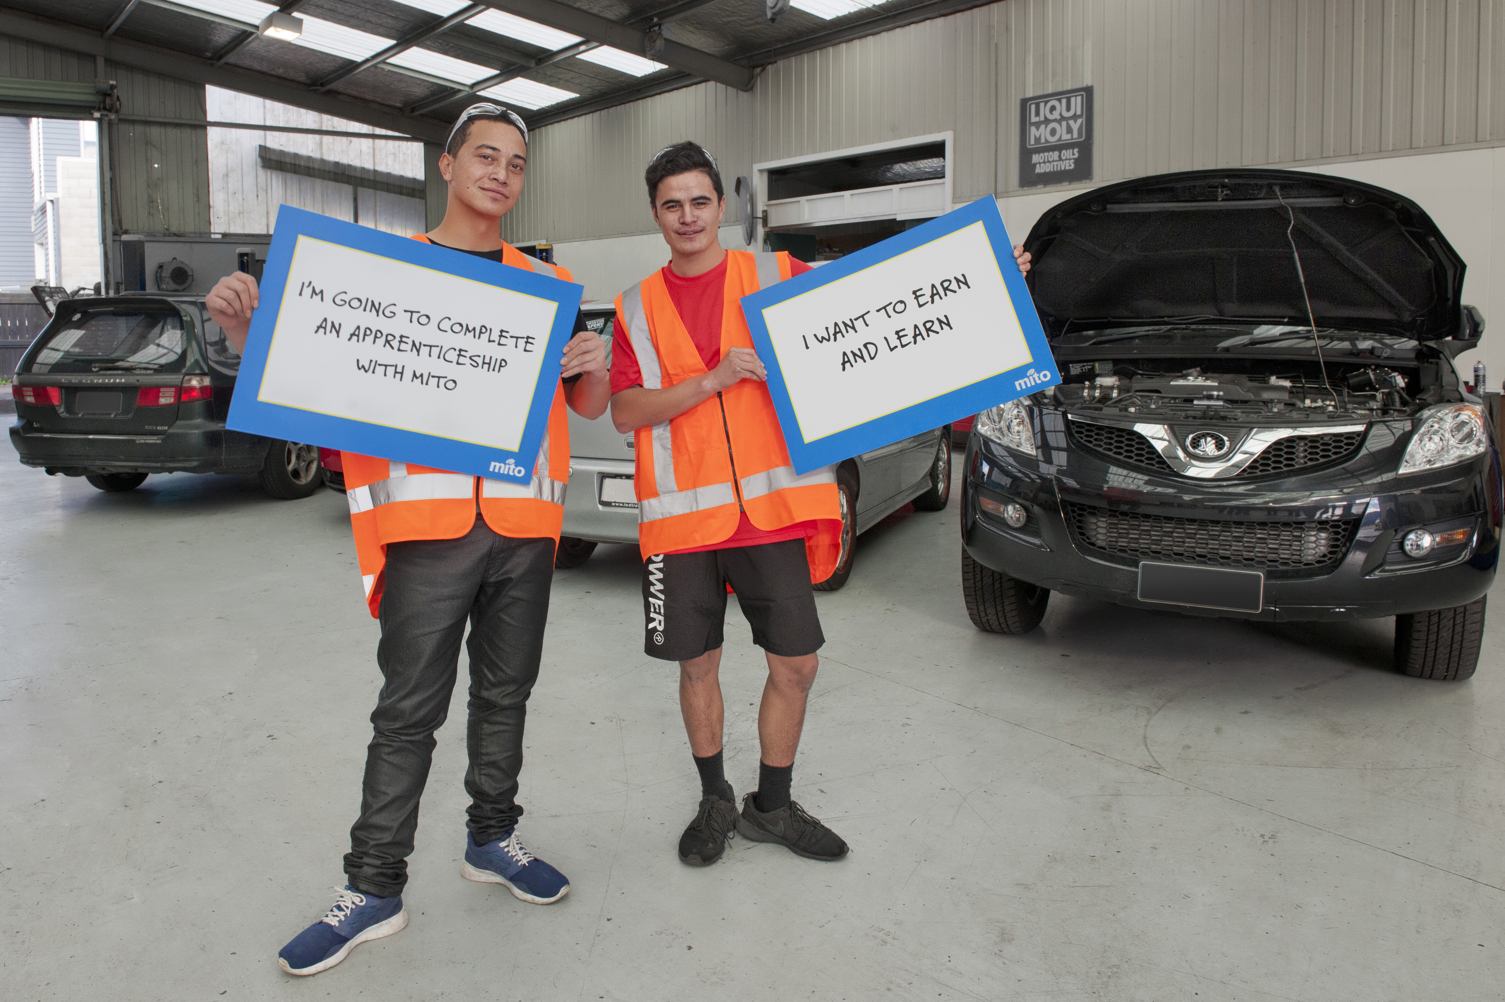
Earn and Learn!
TWO years of free fees
feesfree.govt.nz

Slide 20
He oranga haumako. He waaheke ranga wairua.

