Slide 2
Tracey Eaton
Schools Transition Advisor

Slide 3
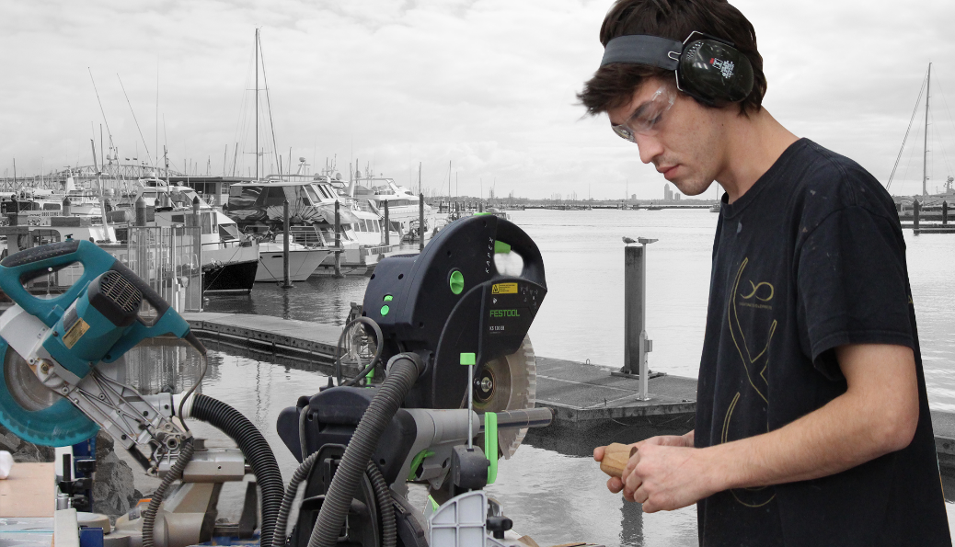
School to Work Programme
Year 12 and 13 students employed on
a part time basis
Learn practical, relevant skills for 1 or 2 days
a week while still at attending school
Earn credits contributing towards level 2 & 3
NCEA attainment
Make informed decisions about future
pathways
Smooth transition from the classroom
to industry

Slide 4
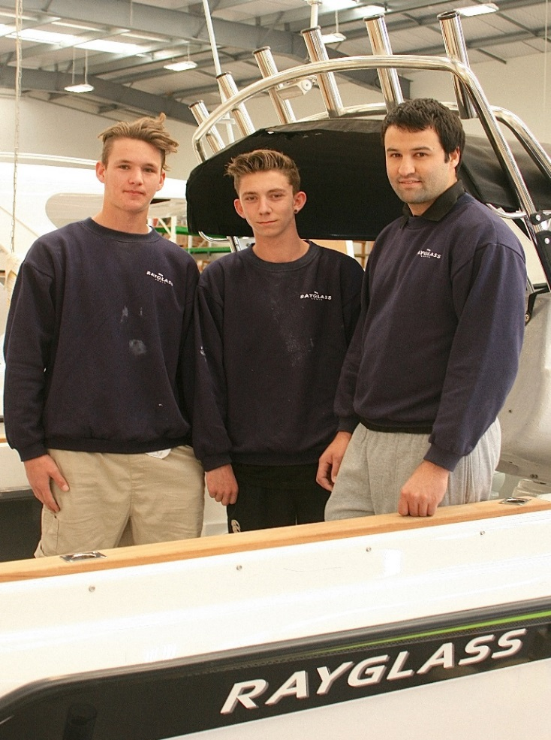
Benefits
Explore new career options
Experience practical and theory based training
Learn transferrable skills
Mentored by industry experts
Flexible placements to suit all stakeholders
Supporting industry connections
Breaking down transitional barriers
Notes:
Having a dedicated Schools Transition Advisor has means that students are screened and matched and introduced at the best workplace for them
Factors taken into account include interests, vicinity to home and transport
Where there is a will there is a way and for a student who was desperate to work for a superyacht builder in Hobsonville Point, he was getting up at 530am each day, catching 2 buses to get to work on time, now in his second
year of his apprenticeship
Work backwards – find the workplace and connect suitable, enthusiastic students to the employers
Work with student, whanau and school to ensure successful outcomes
The model is based on a 3 + 2 / 4 + 1 placement, but this is all worked around what suits the student, school and the employer. Often school holidays are worked, purely as more exposure to a workplace = greater knowledge to assist decision making about the future
Education is key – we have the knowledge of our industry, we have the relationships with our employers
Students who have had problems achieving at school are suddenly transformed by the workplace learning experience
Transformational - very satisfying to see students 10 Ft. tall and bullet proof after finding the work enjoyable and the assessments doable because they are interesting and relevant for students
Many students, who have not previously succeeded in the classroom are using their marine credits to pass NCEA L 2 & 3
Pastoral care throughout has been great support to the students

Slide 5
Feedback from Schools
Transforming, from a student who was unable to get out of bed in the morning to happy, engaged and getting up early to get to work on time
Peers at school acknowledging the change they see in their mate
Allowing a mini step into industry without the decision to leave school just yet
Student felt respected and valued in the workplace
We value the proactive approach your ITO is taking

Slide 6
Feedback from Parents
Work days have been the highlight of his week
The experience has helped cement in his mind that the marine industry is where he wants to start his career
I cannot emphasise how much this has changed our son’s life
He was struggling to find his forte, we have watched his confidence grow and his enthusiasm return
A joy to see him with a smile on his face before leaving for work
He now has a real purpose and the means to chase his dreams

Slide 7
Click the link below to view the video
School to Work

Slide 8
Ben Birdsall
Graduate
National Certificate in Composite and Wooden Boatbuilding (Level 4)

Slide 12
Mike Birdsall
NZ Marine & Composites Field Officer

Slide 14
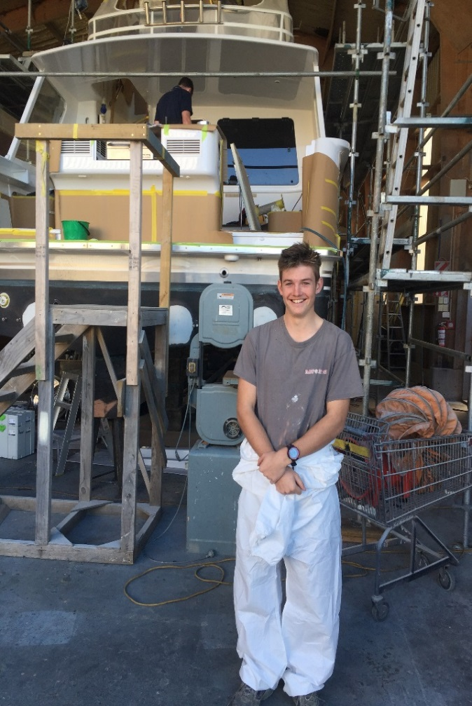
Types of Work in the Marine Industry
Boatbuilding in alloy, composite, wood, steel
Composite production
Marine systems engineering
Power boat systems and servicing
Electrical / electronics
Marine interiors
Marine painting
Sail or spar making
Marina operations

Slide 15
Freephone: 0800 600 242 Phone: +64 09 360 0056 Web: www.nzmacito.org.nz
Email: training@nzmarine.com

