Slide 1
Growing
People,
Growing
New Zealand
Matiu Julian
National Manager, Māori Business

Slide 2
Growing
People,
Growing
New Zealand

Slide 3
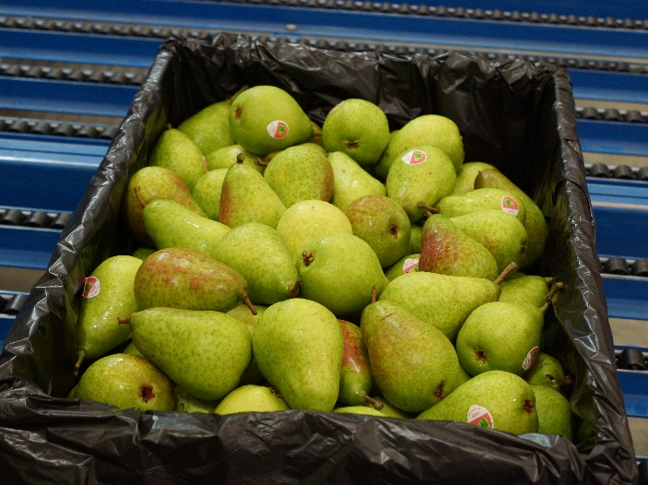
MAORI WORKING IN THE PRIMARY INDUSTRIES
14.7% of those working in the primary industries are Māori
High levels of Māori are employed in processing sectors (meat, seafood and dairy)
16% of all Primary ITO trainees are Māori
In large companies, Māori tend to be concentrated in entry and lower-level roles, with a few in middle management. Senior managers are almost non-existent.

Slide 4
FOOD & PLANT PRODUCTION SECTORS
Dairy Farming
9% of total workforce
Sheep, Beef & Deer
8% of total workforce
Poultry
15% of total workforce
Horticulture Production
10% of total workforce
Nursery Production
7% of total workforce
Pork
10% of total workforce

Slide 5
FOOD PROCESSING SECTORS
Meat Processing
31% of total workforce
Seafood
20% of total workforce
Dairy Processing
16% of total workforce

Slide 6
SERVICE SECTORS
Sports Turf
14% of total workforce
Arboriculture
15% of total workforce
Amenity Horticulture
10% of total workforce
Landscaping
12% of total workforce
Wool Harvesting
55% of total workforce

Slide 7
PRIMARY ITO’S MAORI STRATEGY
VISION FOR 2025
2. Significantly increase the number of Māori businesses we work with in the primary industries
4. Build the bicultural capability and capacity of Primary ITO
1. Provide strategic leadership across the primary industries to maximise impact and alignment in growing the Māori workforce
3. Attract, train & retain more Māori at all levels within the primary industries
New Zealand has a highly-skilled Māori workforce in the primary industries operating at all levels across the value chain.
Businesses – including Māori-owned enterprises – have a Māori talent pool of significant depth to draw on. From workers, managers and owners through to senior managers and governors, Māori have thriving careers at all levels and are enriching our primary industries.
Tertiary education is a key enabler that supports Māori individual and collective aspirations within the primary industries, and Māori development generally. Primary ITO actively works alongside Māori partners together with industry partners to optimise Māori success.
Our Industry Partners
Our Customers
Our Learners
Our People

Slide 8
GROWING A MAORI TALENT PIPELINE
Pre-work
Entry-level
Mid-career
Senior management
3 KEY AREAS
Depth & development of the Māori talent pool
Recruiting & attracting Māori talent
Retaining Māori talent (and the impact of organisational culture)

